Slide 1
Certification Prep (or Immersive) session: CPS-CRT201
Presenter: Mark Grimes
Alias: mgrimes

Slide 2

About Mark
Residence SE Michigan
Beautiful Wife & 3 kids
MCT nearly two decades
Consulting Experience
8.5 years @ Microsoft
About 5 years with Sogeti/Capgemini
WW Identity Community Lead
aka.ms/Identity
TechNet Blogger & Twitter
aka.ms/MarkGrimes
@markbgrimes
What I do otherwise
Cycling (Zwift), Snow Skiing and Photography

Slide 4
What an exam prep session is NOT
What we don’t do during exam prep:
… Sharing actual exam questions or answers
… where to find “braindumps”
… a guarantee for passing the exam

Slide 5
Agenda
Certification Resources @ Ready
The Certification Program
The Certification Paths
Exam Objectives’ review az-300
Next steps

Slide 6
Microsoft Certification @ Ready

Slide 7
What do we have for you @ Ready?
12 Cert Prep Sessions – Technology Focused (200 and 300 level)
Onsite Testing Center (take any of the new role based exams)
Information about new Certifications, Learning resources, and more…

Slide 8
Microsoft Certification - The Program aka.ms/CertBlog

Slide 9

Microsoft certifications
Apps & Infra
Data & AI
Modern Workplace
Business Apps
Expert
Azure Solution Architect
Azure DevOps Engineer
M365
Enterprise Administrator
Functional Consultant Sales
Functional Consultant Customer Service
M365 Modern Desktop Administrator
M365 Teamwork Administrator
Functional Consultant Field Service
Functional Consultant Marketing
Azure
Administrator
Azure
Developer
Azure
Data Scientist
Azure
AI Engineer
Associate
3/31/19
3/31/19
Functional Consultant Financials
Functional Consultant Manufacturing
Azure
Security Engineer
Azure
Data Engineer
M365 Messaging Administrator
M365 Security Administrator
3/31/19
3/31/19
3/31/19
Functional Consultant Supply Chain Mgt.
3/31/19
Fundamentals
Azure
Fundamentals
Azure
Fundamentals
Microsoft 365
Fundamentals
Dynamics 365
Fundamentals
3/31/19
aka.ms/RoleBasedCertifications

Slide 10
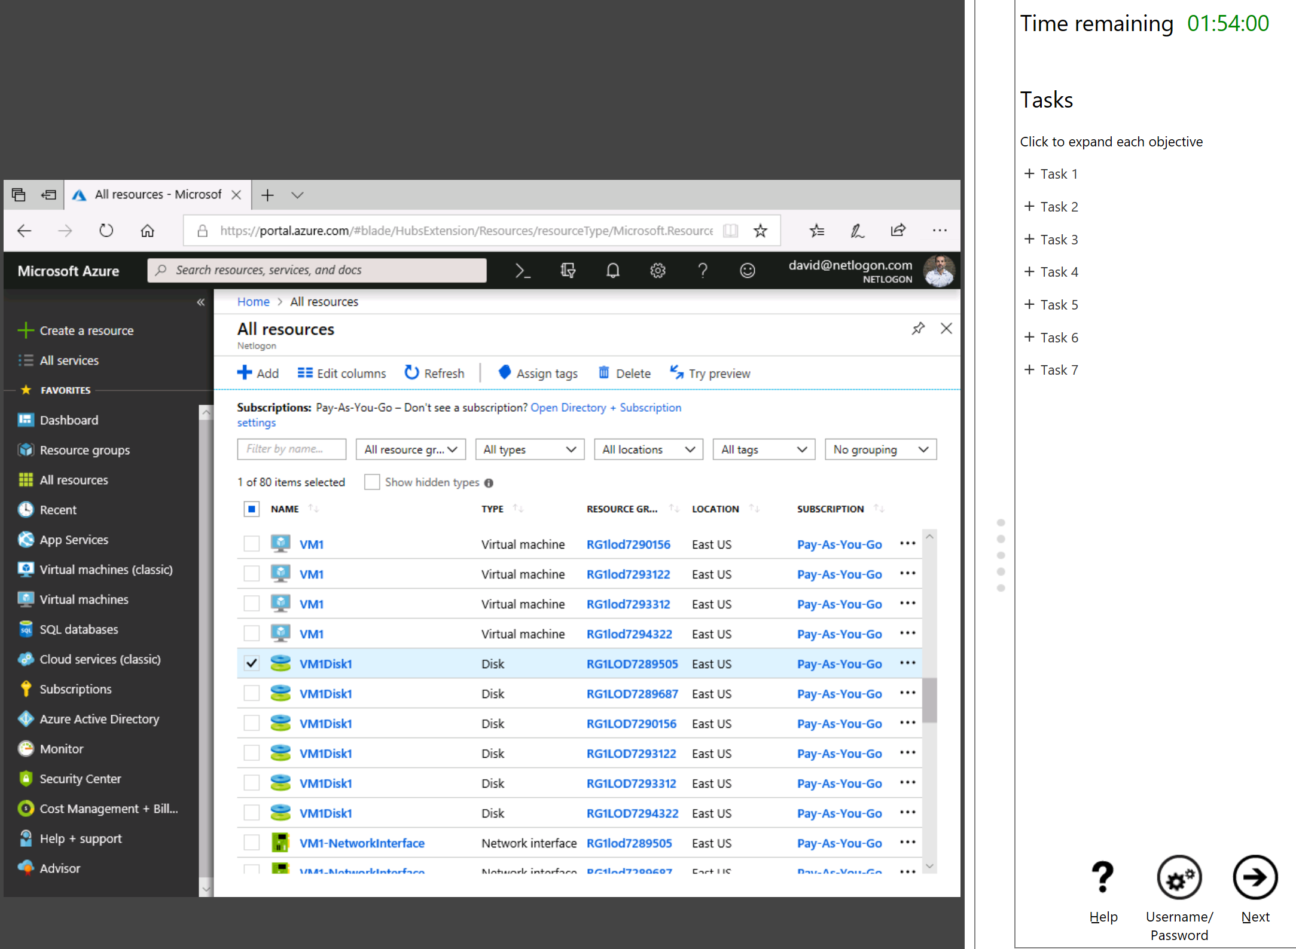

Introducing performance-based testing
Prove your skills with hands-on labs
Starting with Azure, each job role certification will have performance-based labs
Map to what you do everyday
Demonstrate your skills using the technology
At least one exam in certification will have labs; that exam have at least 2 labs with 7-9 tasks
Notes:
Speaker Notes:
We are introducing performance-based testing because you asked for it!
Performance Based Labs will be introduced after the exam comes out of beta
Demonstrate skills rather than just answering questions about them
introduces Performance Based Testing (all certifications will include Performance testing at some point, right now, its included in AZ-100/101/300, but soon in MS-100,201,500 and MD-100).

Slide 11
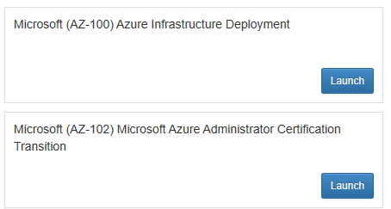
Measure Up
To use a MeasureUp voucher
Set aside time to study for the test. Only use a voucher if you will take the practice test in the next 30 days.
Go to http://mslibrary.measureup.com/
Select the MeasureUp Microsoft MCP or MTA practice text you'd like to take.
Click Launch
Notes
Your voucher is active for 30 days. During that time, you will not use another voucher when you visit your practice exam.
The voucher is only applicable on Microsoft Certification practice tests.

Slide 12
Microsoft Certification - Your Path

Slide 13
Learning path for Azure Solutions Architect Expert
Skills required for certification
Exams
Certification
Workloads and security
Deploy apps
Developing for the cloud
& Storage
AZ-300: Microsoft Azure Architect Technologies Exam
Configure infrastructure
Secure data
Online courses and instructor-led training available to support learning
Microsoft Certified: Azure Solutions Architect Expert
Workload
Requirements
Identity and security
Data platform solution
Deployment, migration, and integration
Infrastructure strategy
AZ-301: Microsoft Azure Architect Design Exam
Microsoft Certification: aka.ms/RoleBasedCert
Learning Partner: aka.ms/LearningPartner
Microsoft Learn: Microsoft.com/Learn

Slide 14
How to prepare and take the Exam
What to buy or use to study with
Almost everything written that you need can be found at azure.microsoft.com
Get a Free trial account.
Ignite Hands-On Workshops/Labs
Microsoft Virtual Academy (MVA)
When doing a Prep Exam
Select all of the questions for a particular topic, then click END. Review all the answers right and wrong
Before you Press Start
Have a mental cheat sheet
Right before you start – DUMP IT on the paper they give you for notes
Then when you START ..Try to answer the Case Study Questions first, BEFORE reading the Case Study!

Slide 15
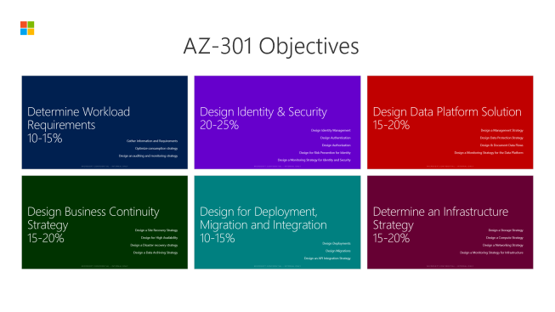
Microsoft Certification - Exam AZ-300 aka.ms/az-300
Notes:
aka.ms/az-300
aka.ms/az301

Slide 16
Using this Deck to Study…
Some slides have multiple animations
They may hide really important content!
To use this deck to study with use in “Slide Show” mode F5*
Then you will see all content AND links will work ☺
The “Click to Zoom” slide next allows you to jump to topics *

Slide 17
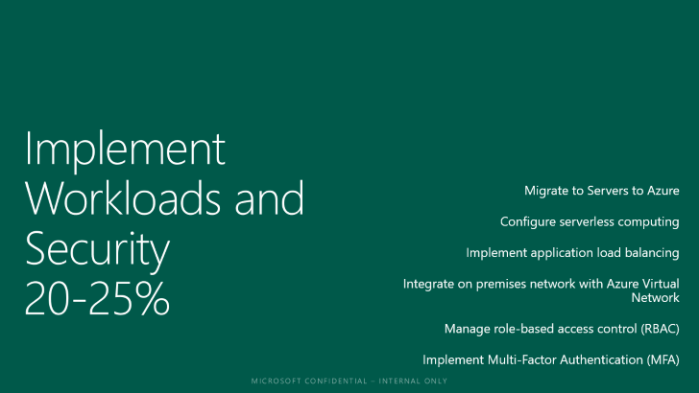

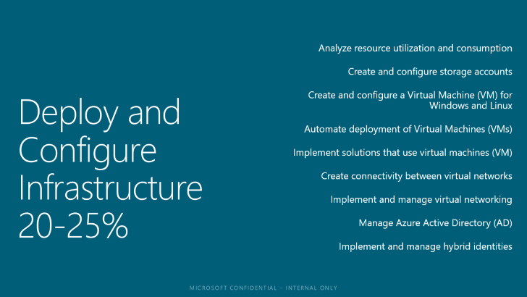
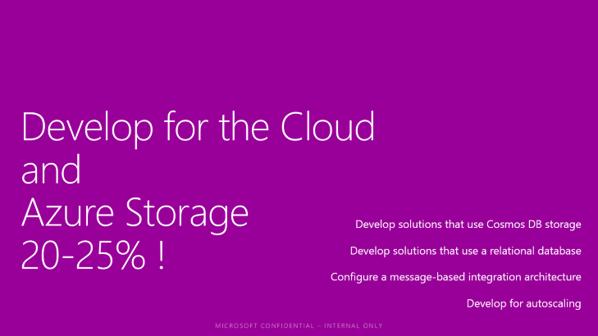
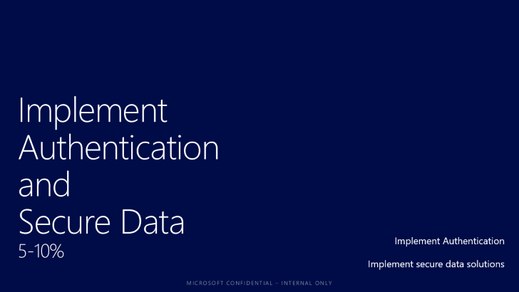
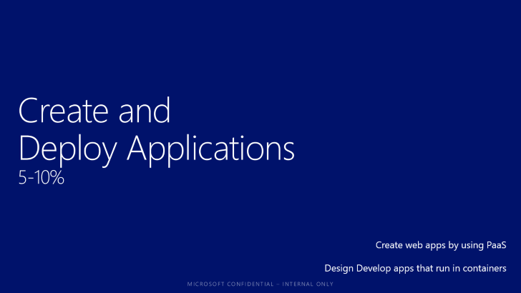
AZ-300 Objectives

Slide 18
Deploy and Configure Infrastructure 20-25%
Analyze resource utilization and consumption
Create and configure storage accounts
Create and configure a Virtual Machine (VM) for Windows and Linux
Automate deployment of Virtual Machines (VMs)
Implement solutions that use virtual machines (VM)
Create connectivity between virtual networks
Implement and manage virtual networking
Manage Azure Active Directory (AD)
Implement and manage hybrid identities
Notes:
aka.ms/az-300
aka.ms/az301

Slide 19
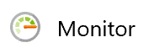

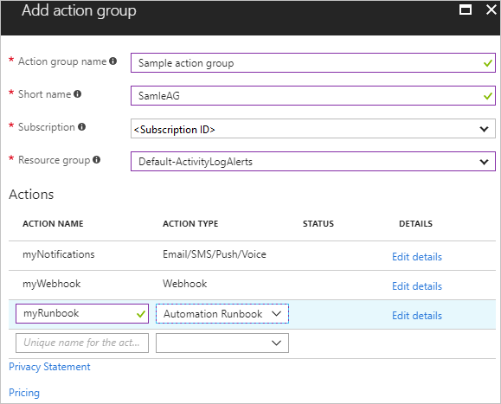
Analyze resource utilization and consumption
Create & Manage Action Groups
defined by Subscription Owner
Define Action Type
Email/SMS/Push/Voice, Logic App, Webhook, ITSM, or Automation
Runbook
Action Specific information
Emails, ITSM, Logic Apps. Function App, Runbook, SMS, Voice,
Webhook
aka.ms/Azure/ActionGroups
Notes:
Analyze resource utilization and consumption
May include but not limited to: Configure diagnostic settings on resources; create baseline for resources; create and rest alerts; analyze alerts across subscription; analyze metrics across subscription; create action groups; monitor for unused resources; monitor spend; report on spend; utilize Log Search query functions; view alerts in Log Analytics
An action group is a collection of notification preferences defined by the owner of an Azure subscription. Azure Monitor and Service Health alerts use action groups to notify users that an alert has been triggered. Various alerts may use the same action group or different action groups depending on the user's requirements. You may configure up to 2,000 action groups in a subscription.

Slide 20
Configure network access to storage accounts
Configure storage accounts -allow access from specific VNets
Includes paired regions
Permissions: Join Service to a Subnet (part of Storage Account Contributor)
Account and Network can be in different subscription
BUT – must be in same Azure AD Tenant!
Know EXCEPTIONS to Network Rules
e.g. Backup, ASR, DevTest, Monitor etc..
Notes:
Create and configure storage accounts
May include but not limited to: Configure network access to the storage account; create and configure storage account; generate shared access signature; install and use Azure Storage Explorer; manage access keys; monitor activity log by using Log Analytics; implement Azure storage replication
Traffic from your VNet to the Azure service always remains on the Microsoft Azure backbone network.
To apply a virtual network rule to a storage account, the user must have the appropriate permissions for the subnets being added. The permission needed is Join Service to a Subnet and is included in the Storage Account Contributor built-in role. It can also be added to custom role definitions.

Slide 21
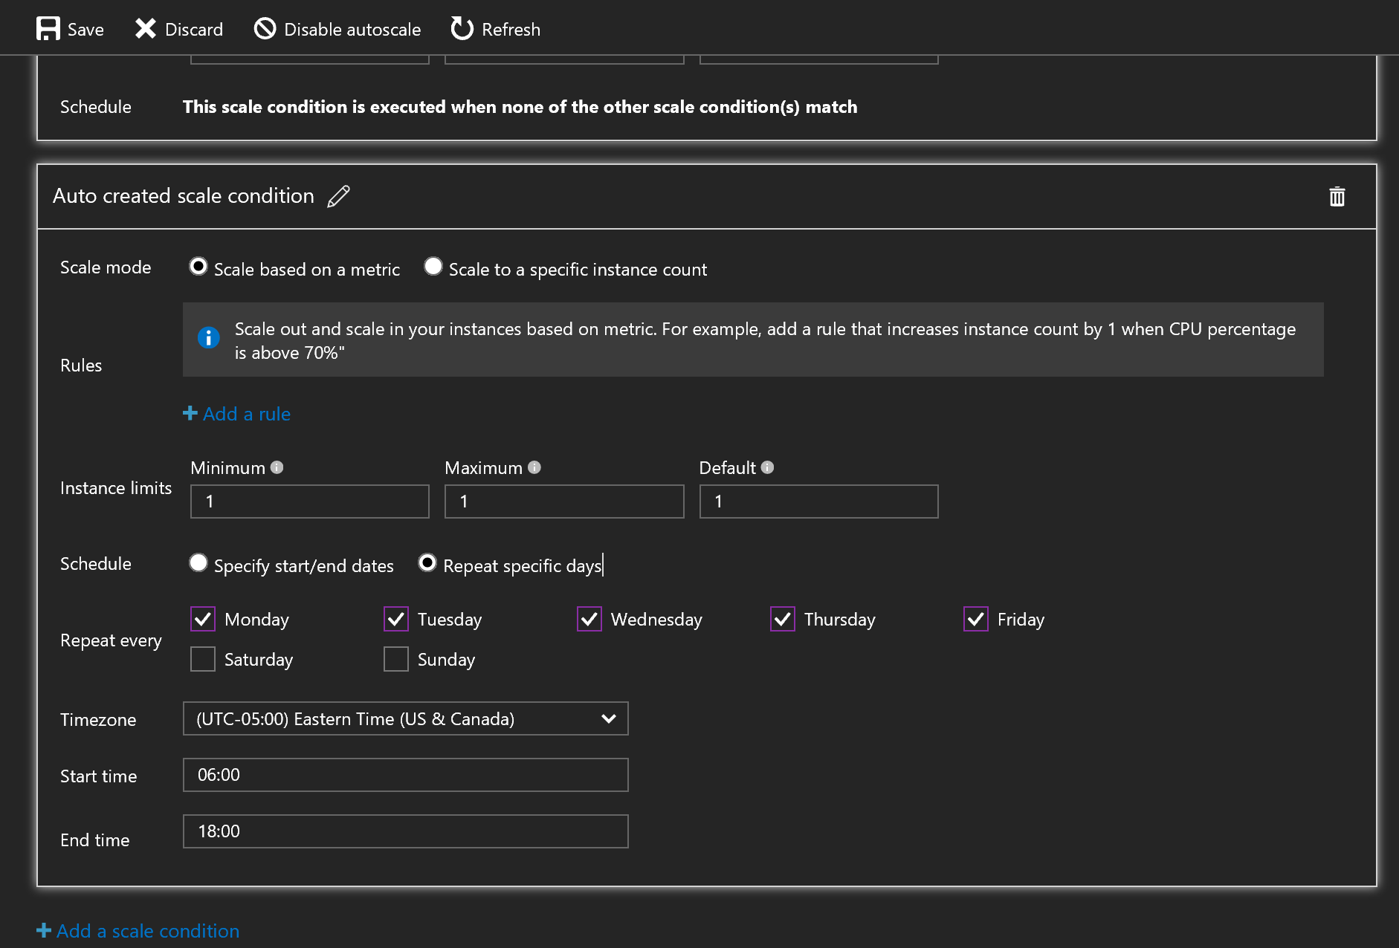
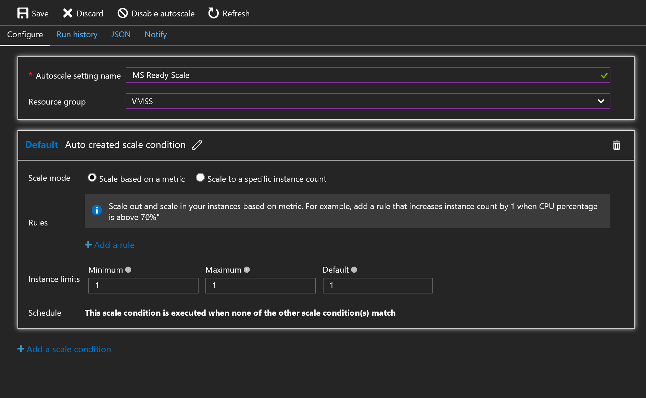
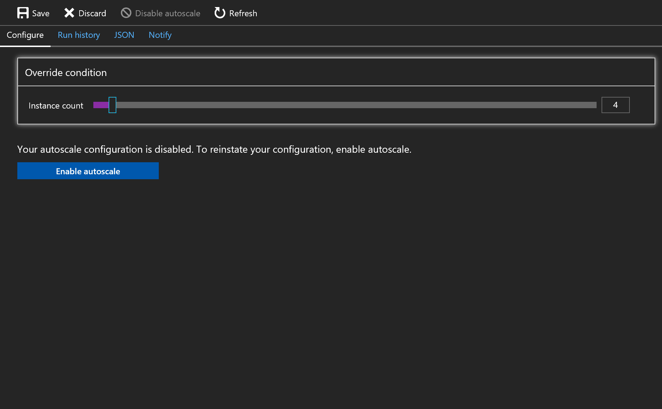
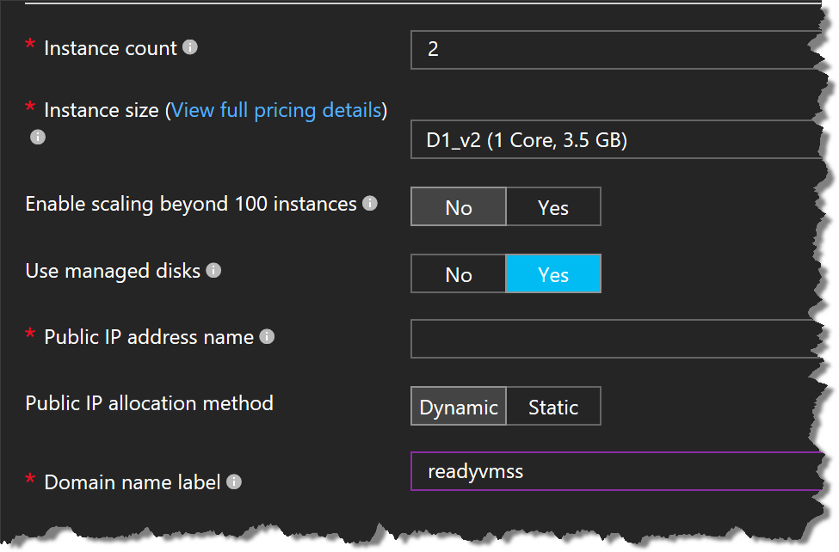
Deploy and configure scale sets
aka.ms/Azure/VMSS
Notes:
Create and configure a Virtual Machine (VM) for Windows and Linux
May include but not limited to: Configure high availability; configure monitoring, networking, storage, and virtual machine size;

Slide 22
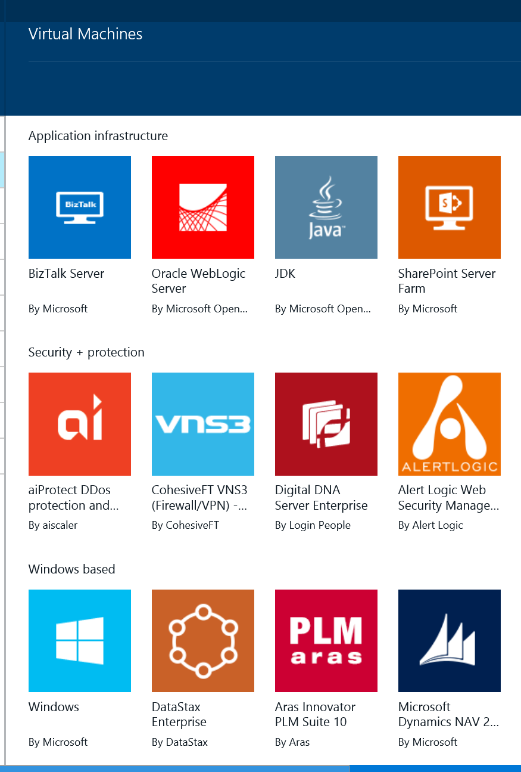
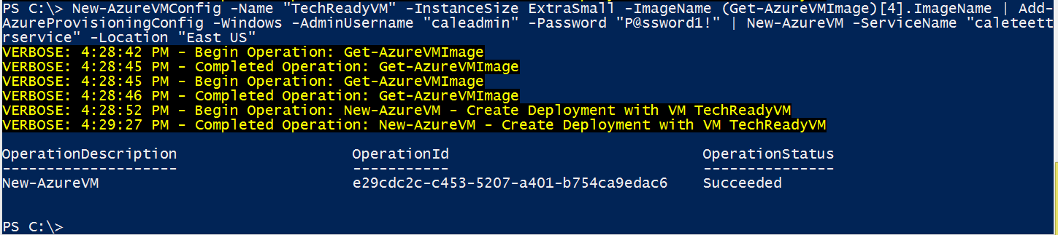
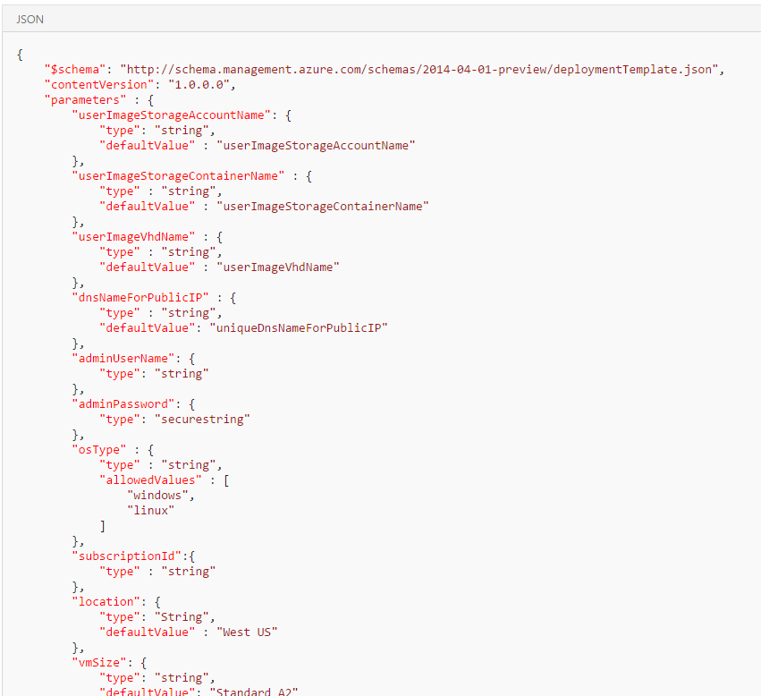
Automate deployment of VMs
Deployment options
Marketplace
PowerShell
Azure CLI
ARM Template
Portal
Code (C#/Java/Python)
Different ways to create a VM
Notes:
Automate deployment of Virtual Machines (VMs)
May include but not limited to: Modify Azure Resource Manager (ARM) template; configure location of new VMs; configure VHD template; deploy from template; save a deployment as an ARM template; deploy Windows and Linux VMs

Slide 23
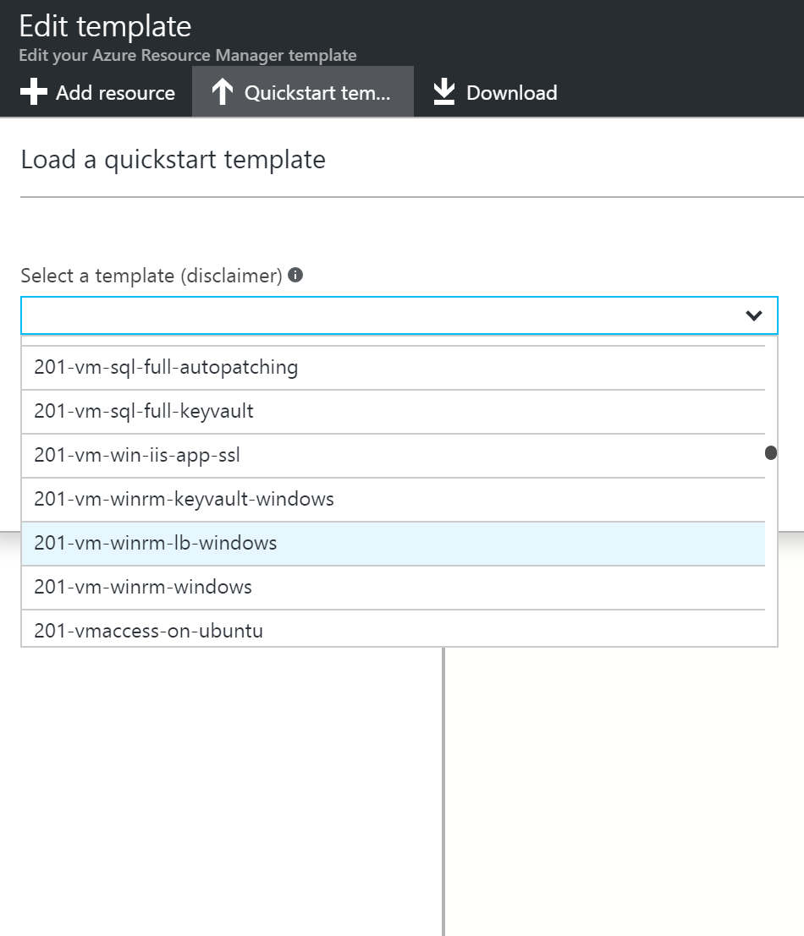
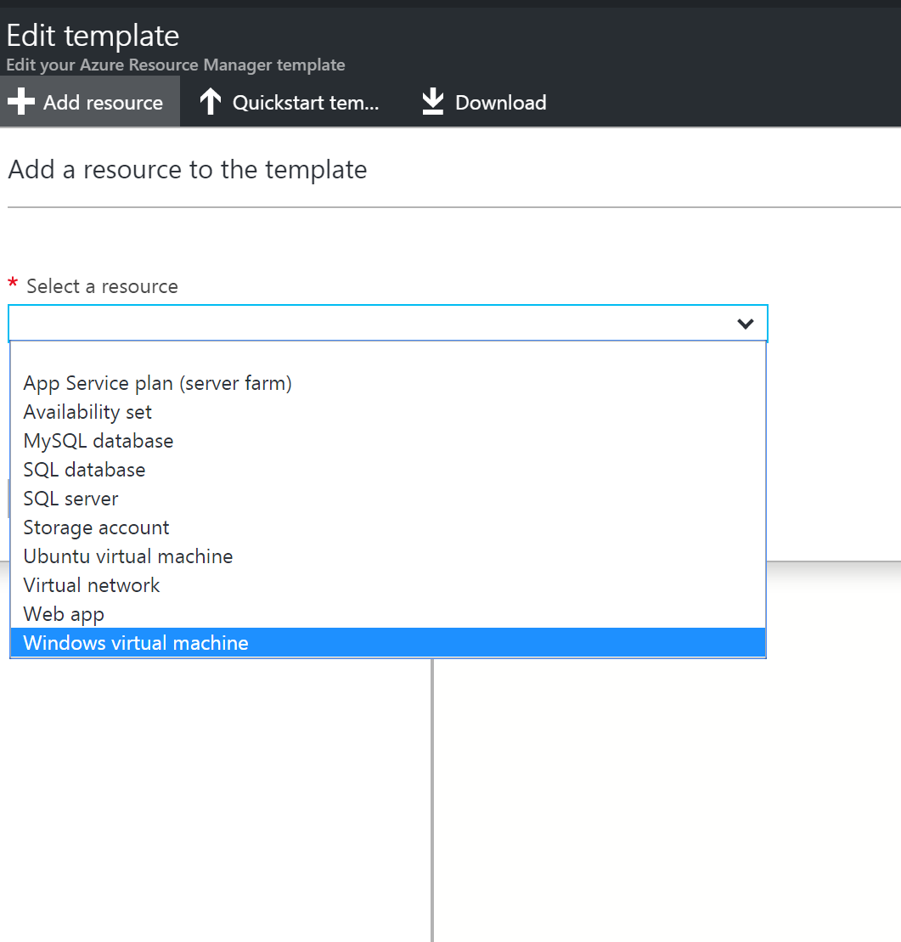
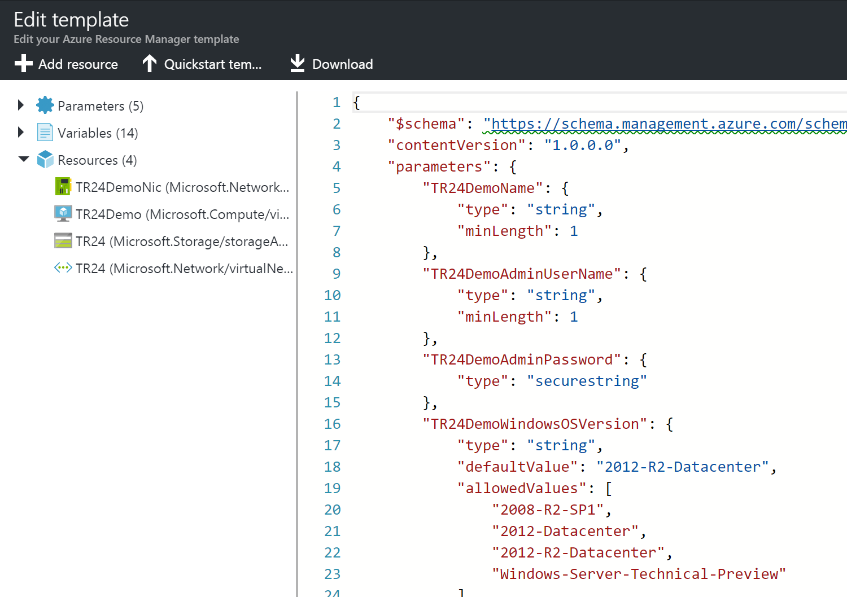
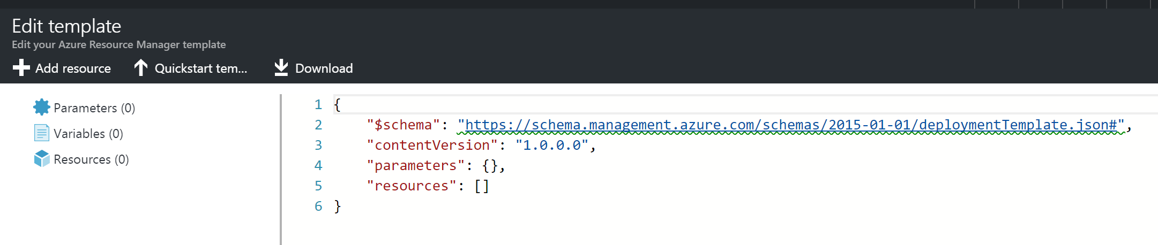
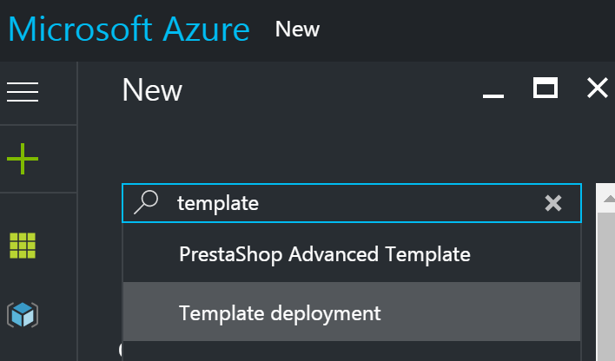
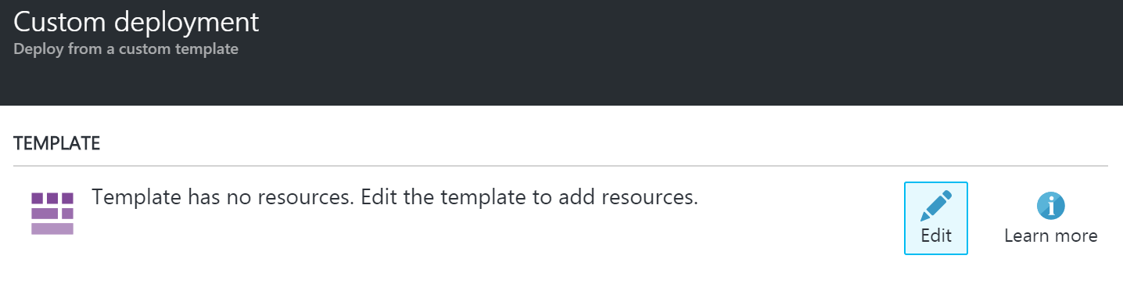
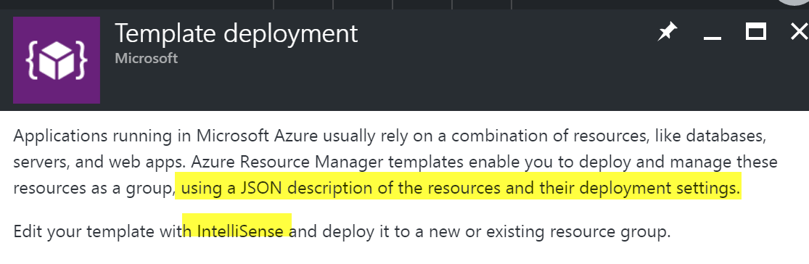
Automate deployment of VMs
ARM Template Walkthrough
Notes:
Automate deployment of Virtual Machines (VMs)
May include but not limited to: Modify Azure Resource Manager (ARM) template; configure location of new VMs; configure VHD template; deploy from template; save a deployment as an ARM template; deploy Windows and Linux VMs

Slide 24
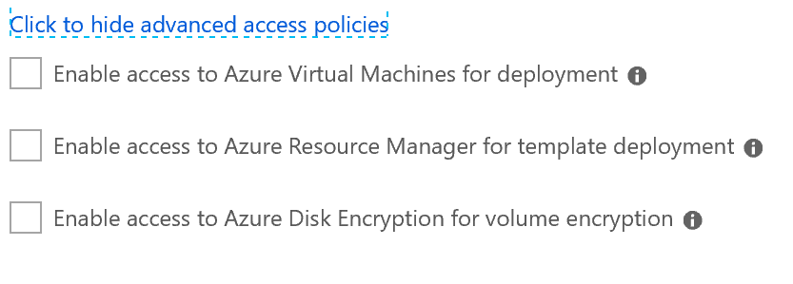
Implement solutions that use virtual machines (VM)
Configure Azure Disk Encryption for VMs – Prerequisites to know
Key Vault | Access Policies | Key Encryption Key (KEK)
Networking
Group Policy
Tiers!!!
https://docs.microsoft.com/en-us/azure/security/azure-security-disk-encryption-faq
Notes:
Azure Disk Encryption is available on standard tier VMs including A, D, DS, G, GS, and F series IaaS VMs. It's also available for VMs with premium storage. It isn't available on basic tier VMs.
Networking and Group Policy
To enable the Azure Disk Encryption feature, the IaaS VMs must meet the following network endpoint configuration requirements:
To get a token to connect to your key vault, the IaaS VM must be able to connect to an Azure Active Directory endpoint, [login.microsoftonline.com].
To write the encryption keys to your key vault, the IaaS VM must be able to connect to the key vault endpoint.
The IaaS VM must be able to connect to an Azure storage endpoint that hosts the Azure extension repository and an Azure storage account that hosts the VHD files.
If your security policy limits access from Azure VMs to the Internet, you can resolve the preceding URI and configure a specific rule to allow outbound connectivity to the IPs. For more information, see Azure Key Vault behind a firewall.
Group Policy:
The Azure Disk Encryption solution uses the BitLocker external key protector for Windows IaaS VMs. For domain joined VMs, don't push any group policies that enforce TPM protectors. For information about the group policy for “Allow BitLocker without a compatible TPM,” see BitLocker Group Policy Reference.
BitLocker policy on domain joined virtual machines with custom group policy must include the following setting: Configure user storage of bitlocker recovery information -> Allow 256-bit recovery key. Azure Disk Encryption will fail when custom group policy settings for BitLocker are incompatible. On machines that didn't have the correct policy setting, apply the new policy, force the new policy to update (gpupdate.exe /force), and then restarting may be required.

Slide 25
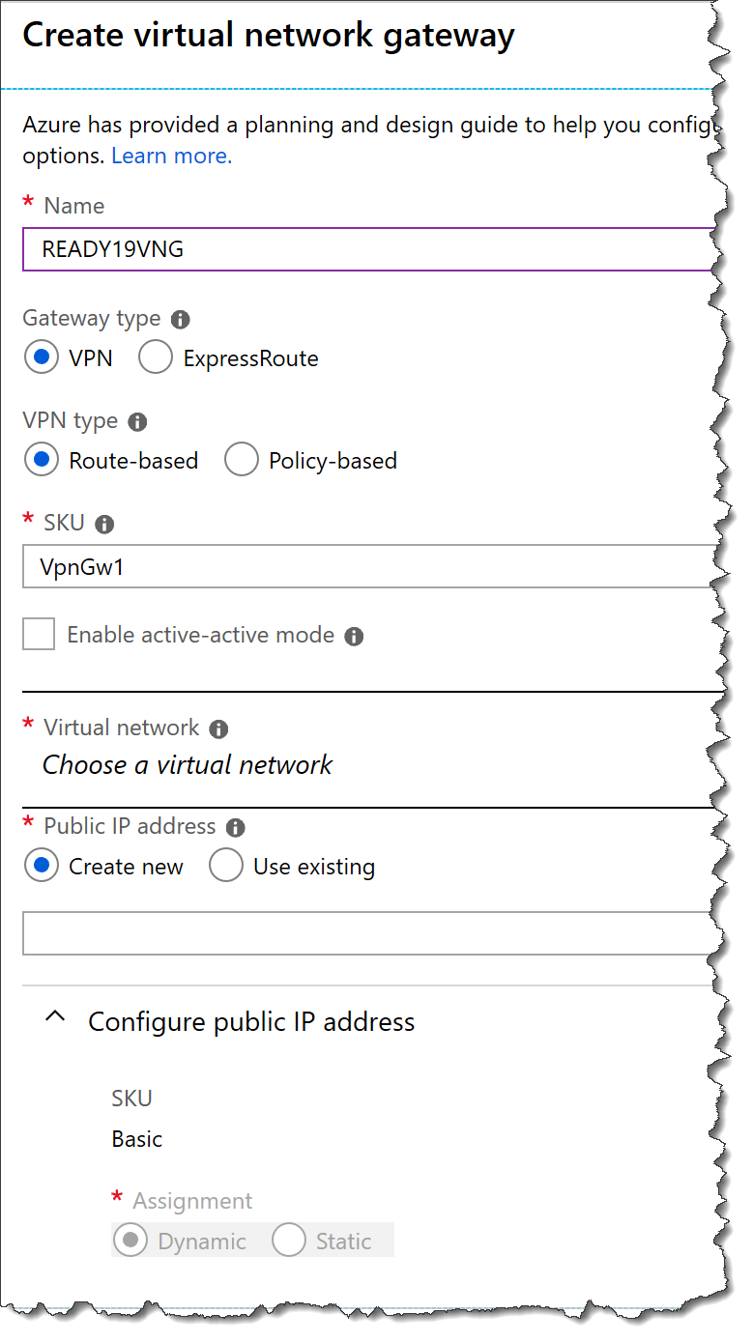
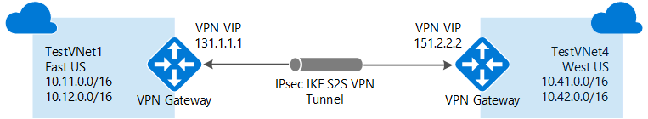
Create connectivity between virtual networks
Create virtual network gateway
GatewaySubnet /27-8 NSG
DNS?
https://docs.microsoft.com/en-us/azure/vpn-gateway/vpn-gateway-howto-vnet-vnet-resource-manager-portal
Notes:
Create connectivity between virtual networks
May include but not limited to: Create and configure VNET peering; create and configure VNET to VNET; verify virtual network connectivity; create virtual network gateway
\When you create a VNet-to-VNet connection, the local network gateway address space is automatically created and populated. If you update the address space for one VNet, the other VNet automatically routes to the updated address space. It's typically faster and easier to create a VNet-to-VNet connection than a Site-to-Site connection.
Before creating a virtual network gateway for your virtual network, you first need to create the gateway subnet. The gateway subnet contains the IP addresses that are used by the virtual network gateway. If possible, it's best to create a gateway subnet by using a CIDR block of /28 or /27 to provide enough IP addresses to accommodate future additional configuration requirements.
DNS isn't required for VNet-to-VNet connections. However, if you want to have name resolution for resources that are deployed to your virtual network, specify a DNS server

Slide 26
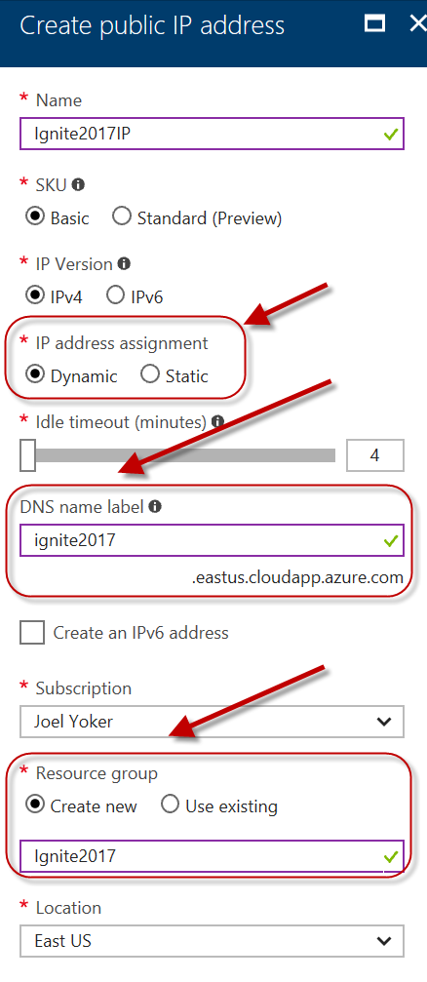
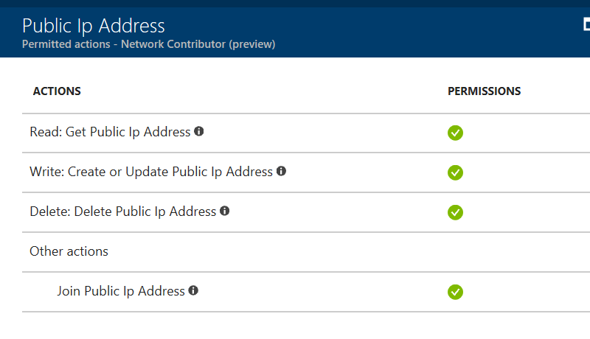
Implement and manage virtual networking
Public IP
Separate Azure Object
Public Azure Service
VMs, ILBs, VPN, App GWs
Dynamic (default) or Static
DNS hostname resolution
Private IP
Allocated from subnet range
Internal resolution by Azure DNS
Subnet, part of VNet range
VM, ILBs, App GWs
Dynamic (default) or Static
aka.ms/Azure/Addresses
Notes:
Implement and manage virtual networking
May include but not limited to: Configure private and public IP addresses, network routes, network interface, subnets, and virtual network

Slide 27
Manage Azure Active Directory
Configure Self Service Password Reset
Azure AD License?
User Configured?
Authentication Method for Policy?
Where is password managed? PHS, PTA or AD FS
Gates?
Know Versions / Features
Notes:
Manage Azure Active Directory (AD)
May include but not limited to: Add custom domains; configure Azure AD Identity Protection, Azure AD Join, and Enterprise State Roaming; configure self-service password reset; implement conditional access policies; manage multiple directories; perform an access review
Checks to see if the user’s password is managed on-premises (federated, pass-through authentication, or password hash synchronized). If writeback is deployed and the user’s password is managed on-premises, then the user is allowed to proceed to authenticate and reset their password.
If writeback is not deployed and the user’s password is managed on-premises, then the user is asked to contact their administrator to reset their password.
GATES Mobile app notification (preview)
Know Versions / Features
https://azure.microsoft.com/en-us/pricing/details/active-directory/

Slide 28
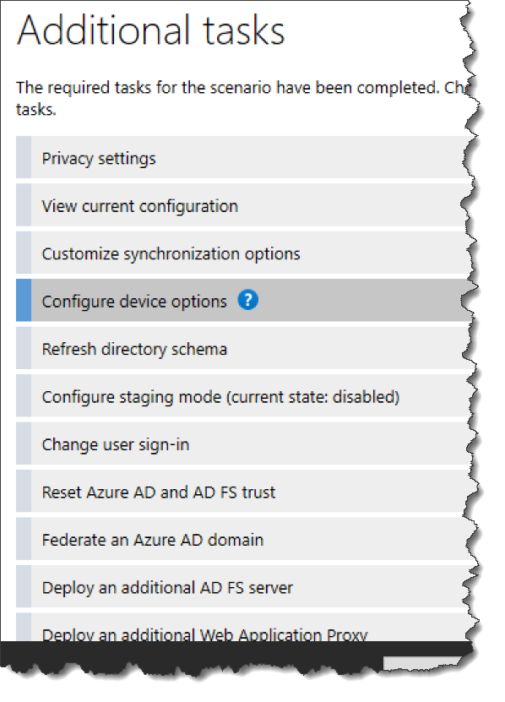
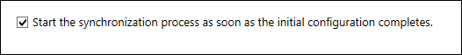
Implement and manage hybrid identities
Manage password sync and writeback
Add Admins -> ADSyncAdmins
Assign Licenses -> Azure AD Premium or EMS
Additional Tasks…
Start synchronization process..
View the selected scenario
Customize synchronization options
Writeback,
Enable Staging Mode
Know custom installation options
Read more
Notes:
Implement and manage hybrid identities
May include but not limited to: Install and configure Azure AD Connect; configure federation and single sign-on; manage Azure AD Connect; manage password sync and writeback
Read more
https://docs.microsoft.com/en-us/azure/active-directory/authentication/howto-sspr-deployment
Know custom installation options also
https://docs.microsoft.com/en-us/azure/active-directory/hybrid/how-to-connect-install-custom
View the selected scenario View your current Azure AD Connect solution. This includes general settings, synchronized directories, and sync settings.
Customize synchronization options Change the current configuration like adding additional Active Directory forests to the configuration, or enabling sync options such as user, group, device, or password write-back.
Enable Staging Mode Stage information that is not immediately synchronized and is not exported to Azure AD or on-premises Active Directory. With this feature, you can preview the synchronizations before they occur.

Slide 29
Implement Workloads and Security 20-25%
Migrate to Servers to Azure
Configure serverless computing
Implement application load balancing
Integrate on premises network with Azure Virtual Network
Manage role-based access control (RBAC)
Implement Multi-Factor Authentication (MFA)
Notes:
aka.ms/az-300
aka.ms/az301
Migrate servers to Azure
May include but not limited to: Migrate by using Azure Site Recovery (ASR); migrate using P2V; configure storage; create a backup vault; prepare source and target environments; backup and restore data; deploy Azure Site Recovery (ASR) agent; prepare virtual network
Configure serverless computing
May include but not limited to: Create and manage objects; manage a Logic App resource; manage Azure Function app settings; manage Event Grid; manage Service Bus
Implement application load balancing
May include but not limited to: Configure application gateway and load balancing rules; implement front end IP configurations; manage application load balancing
Integrate on premises network with Azure virtual network
May include but not limited to: Create and configure Azure VPN Gateway; create and configure site to site VPN; configure Express Route; verify on premises connectivity; manage on-premise connectivity with Azure
Manage role-based access control (RBAC)
May include but not limited to: Create a custom role; configure access to Azure resources by assigning roles; configure management access to Azure; troubleshoot RBAC; implement RBAC policies; assign RBAC roles
Implement Multi-Factor Authentication (MFA)
May include but not limited to: Enable MFA for an Azure tenant; configure user accounts for MFA; configure fraud alerts; configure bypass options; configure trusted IPs; configure verification methods; manage role-based access control (RBAC); implement RBAC policies; assign RBAC Roles; create a custom role; configure access to Azure resources by assigning roles; configure management access to Azure

Slide 30
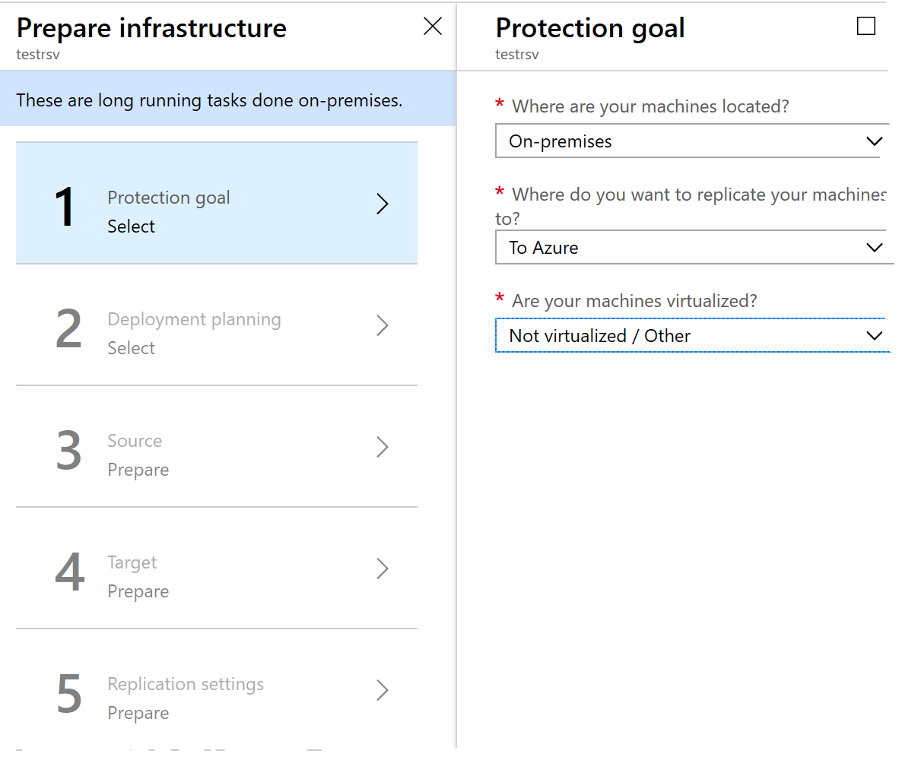
Migrate servers to Azure
Deploy Azure Site Recovery for P2V
Got Permissions?
Create
Virtual Network
Storage Account
Regedit for Mobility Service
Vault
Select protection goal
Set up Source/Target Envs
Create Replication Policy
Enable Replication
P2V Walk Through
P2V
Notes:
Migrate servers to Azure
May include but not limited to: Migrate by using Azure Site Recovery (ASR); migrate using P2V; configure storage; create a backup vault; prepare source and target environments; backup and restore data; deploy Azure Site Recovery (ASR) agent; prepare virtual network
Select what to replicate, and to replicate it to.
Click Recovery Services vaults > vault.
In the Resource Menu, click Site Recovery > Prepare Infrastructure > Protection goal.
In Protection goal, select To Azure > Not virtualized/Other.
P2V
https://docs.microsoft.com/en-us/azure/site-recovery/physical-azure-architecture
Walk Through
https://docs.microsoft.com/en-us/azure/site-recovery/physical-azure-disaster-recovery

Slide 31
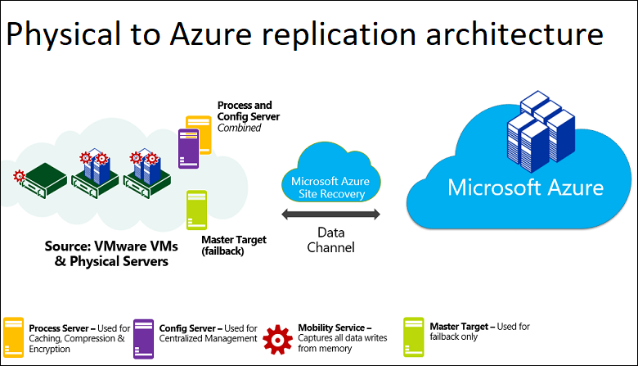
Migrate servers to Azure
Notes:
Migrate servers to Azure
May include but not limited to: Migrate by using Azure Site Recovery (ASR); migrate using P2V; configure storage; create a backup vault; prepare source and target environments; backup and restore data; deploy Azure Site Recovery (ASR) agent; prepare virtual network
P2V
https://docs.microsoft.com/en-us/azure/site-recovery/physical-azure-architecture

Slide 32
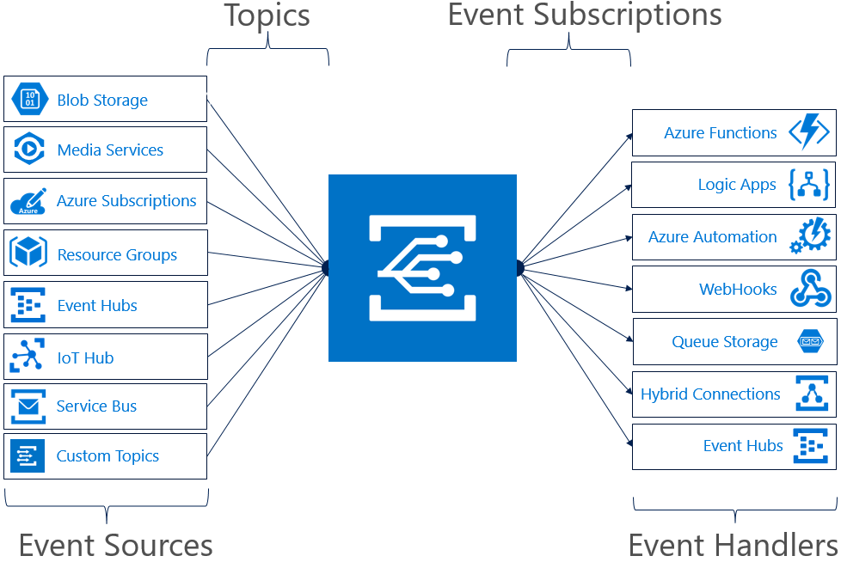
Configure serverless computing
Messaging Services Compare
Manage Event Grid
Connect
Data
Sources
To Handlers
Speed Automation
Enforce Compliance
Event Grid Docs
Notes:
Configure serverless computing
May include but not limited to: Create and manage objects; manage a Logic App resource; manage Azure Function app settings; manage Event Grid; manage Service Bus
Event Grid Docs
https://docs.microsoft.com/en-us/azure/opbuildpdf/event-grid/toc.pdf?branch=live
Messaging Services Compare
https://docs.microsoft.com/en-us/azure/event-grid/compare-messaging-services

Slide 33
Implement application load balancing
Implement front end IP configurations
Required component to create first…
Resource Group | Deploy the required Azure Resources here
Virtual Network | Make an OutBound subnet within
IP Addresses | Need an inbound and outbound public IP address for the Load Balancer
Azure Load Balancer | Will configure the following components A frontend IP that receives the incoming network traffic A backend pool where the frontend IP sends the traffic. A health probe that determines health of the backend VM instances. A load balancer inbound rule that defines how traffic is distributed to the VMs. A load balancer outbound rule that defines how traffic is distributed from the VMs.
Notes:
Implement application load balancing
May include but not limited to: Configure application gateway and load balancing rules; implement front end IP configurations; manage application load balancing
Read More
https://docs.microsoft.com/en-us/azure/load-balancer/configure-load-balancer-outbound-cli

Slide 34
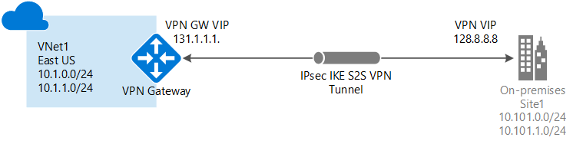
Integrate on premises network with Azure virtual network
Manage Connectivity
Do some Math
Use Perf Tools
iPerf
Address Slow copy issues
Richcopy –multi-threaded ☺
Latency -> tracert
Read more
Notes:
Integrate on premises network with Azure virtual network
May include but not limited to: Create and configure Azure VPN Gateway; create and configure site to site VPN; configure Express Route; verify on premises connectivity; manage on-premise connectivity with Azure
iPerf
It solely produces self-generated TCP traffic from one end to the other. It generated statistics based on experimentation that measures the bandwidth available between client and server nodes. When testing between two nodes, one acts as the server and the other as a client. Once this test is completed, we recommend that you reverse the roles to test both upload and download throughput on both nodes.
https://docs.microsoft.com/en-us/azure/vpn-gateway/vpn-gateway-troubleshoot-site-to-site-cannot-connect
Calculate the maximum expected ingress/egress
Determine your application's baseline throughput requirements.
Determine your Azure VPN gateway throughput limits. For help, see the "Aggregate throughput by SKU and VPN type" section of Planning and design for VPN Gateway.
Determine the Azure VM throughput guidance for your VM size.
Determine your Internet Service Provider (ISP) bandwidth.
Calculate your expected throughput - Least bandwidth of (VM, Gateway, ISP) * 0.8.
Read more
https://docs.microsoft.com/en-us/azure/vpn-gateway/vpn-gateway-howto-site-to-site-resource-manager-portal

Slide 35
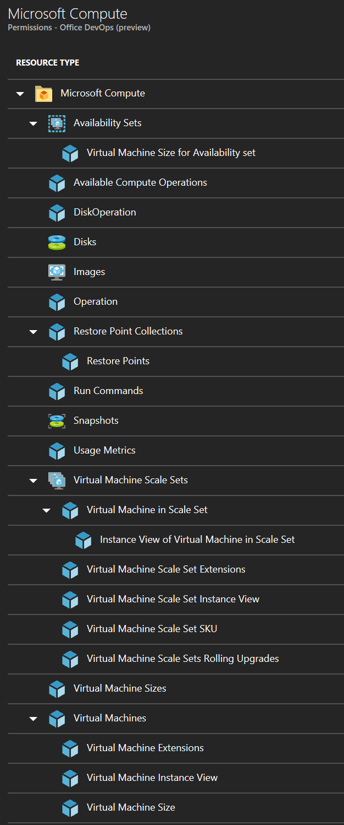
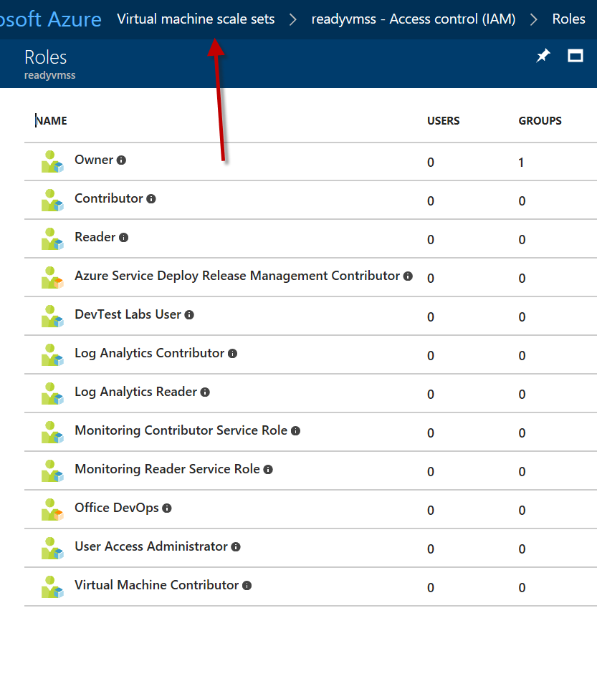
Create Custom role based access controls (RBAC)
(Not) Actions
Not Actions Subtracted from Actions
Assignable Scopes
Subscription, Resource Group, Resource
Also controls who can
view, modify, and delete the role
When to use
When Built-in RBAC does not work
Notes:
Manage role-based access control (RBAC)
May include but not limited to: Create a custom role; configure access to Azure resources by assigning roles; configure management access to Azure; troubleshoot RBAC; implement RBAC policies; assign RBAC roles

Slide 36
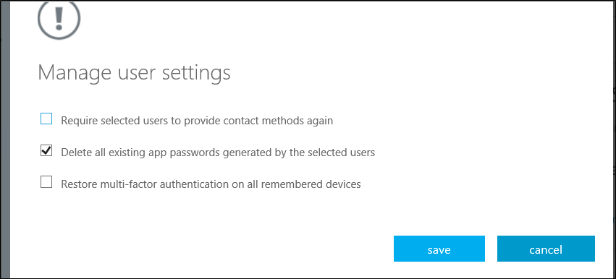
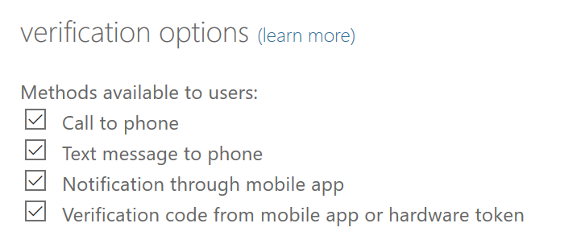
Implement multi factor authentication (MFA)
Configure User Accounts for MFA
Authentication Methods
Get Users to Enroll
aka.ms/mfasetup
Verification Options
Conditional Access Policy
Enable, Disable, Enforce
More settings
https://account.activedirectory.windowsazure.com/usermanagement/mfasettings.aspx
Notes:
Implement Multi-Factor Authentication (MFA)
May include but not limited to: Enable MFA for an Azure tenant; configure user accounts for MFA; configure fraud alerts; configure bypass options; configure trusted IPs; configure verification methods; manage role-based access control (RBAC); implement RBAC policies; assign RBAC Roles; create a custom role; configure access to Azure resources by assigning roles; configure management access to Azure

Slide 37
Create and Deploy Applications 5-10%
Create web apps by using PaaS
Design Develop apps that run in containers
Notes:
aka.ms/az-300
aka.ms/az301

Slide 38
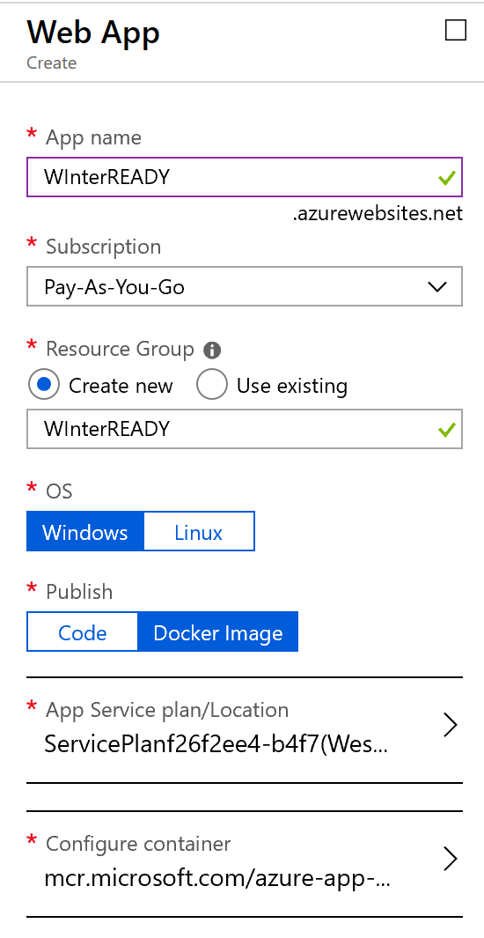

Create web applications by using PaaS
Create an App Service Webjob
Continuous (can do multi-instance)
Triggered
File Types
.cmd, .ps1. .sh, .php, .py, .js, .jar
CRON expressions (Azure Functions)
{second}{minute}{hour}{day}{month}{day-of-week}
CRON?
Compare Flow, Logic Apps, Functions and Webjobs
Notes:
Create web apps by using PaaS May include but not limited to:
Create an Azure App Service Web App; create documentation for the API; create an App Service Web App for containers; create an App Service background task by using WebJobs; enable diagnostics logging
WebJobs is a feature of Azure App Service that enables you to run a program or script in the same context as a
web app, API app, or mobile app.
Compare Flow, Logic Apps, Functions and Webjobs
https://docs.microsoft.com/en-us/azure/azure-functions/functions-compare-logic-apps-ms-flow-webjobs

Slide 39
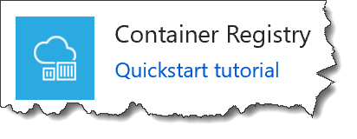
Design and develop applications that run in containers
Publish an Image to Azure Container Registry
SKUs
Basic | Standard | Premium
Create a Container Registry
az acr login –name <acrName>
docker pull hello-world
docker tag hello-world <acrLoginServer>/hello-world:v1
docker push <acrLoginServer>/hello-world:v1
docker rmi <acrLoginServer>/hello-world:v1
Notes:
Design and develop apps that run in containers
May include but not limited to: Configure diagnostic settings on resources; create a container image by using a Docker file; create an Azure Container Service (ACS/AKS); publish an image to the Azure Container Registry; implement an application that runs on an Azure Container Instance; manage container settings by using code
An Azure container registry is a private Docker registry in Azure where you can store and manage your private Docker container images.
Before pushing and pulling container images, you must log in to the ACR instance.
To push an image to an Azure Container registry, you must first have an image. If you don't yet have any local container images, run the following docker pull command to pull an existing image from Docker Hub. For this example, pull the hello-world image.
Tag the image using the docker tag command. Replace <acrLoginServer> with the login server name of your ACR instance.
Finally, use docker push to push the image to the ACR instance
After pushing the image to your container registry, remove the hello-world:v1 image from your local Docker environment. (Note that this docker rmi command does not remove the image from the hello-world repository in your Azure container registry.)

Slide 40
Implement Authentication and Secure Data 5-10%
Implement Authentication
Implement secure data solutions
Notes:
aka.ms/az-300
aka.ms/az301

Slide 41
Implement authentication
Implement OAuth2 authentication
Register application with Azure AD Tenant
Web App – need Sign-On URL
Native App, need Redirect URL of App (sign-in)
Take Application ID
Notes:
Implement authentication May include but not limited to: Implement authentication by using certificates, forms-based authentication, tokens, or Windows-integrated authentication; implement multi-factor authentication by using Azure AD; implement OAuth2 authentication; implement Managed Service Identity (MSI) Service Principal authentication
The consent framework is built on OAuth 2.0 and its various flows, such as authorization code grant and client credentials grant, using public or confidential clients. By using OAuth 2.0, Azure AD makes it possible to build many different types of client applications--such as on a phone, tablet, server, or a web application--and gain access to the required resources.
The quintessential OAuth2 authorization code grant is the authorization grant that uses two separate endpoints. The authorization endpoint is used for the user interaction phase, which results in an authorization code. The token endpoint is then used by the client for exchanging the code for an access token, and often a refresh token as well.

Slide 42
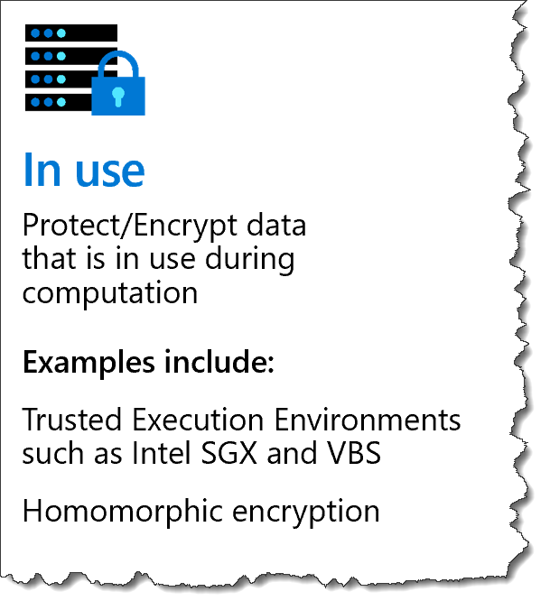
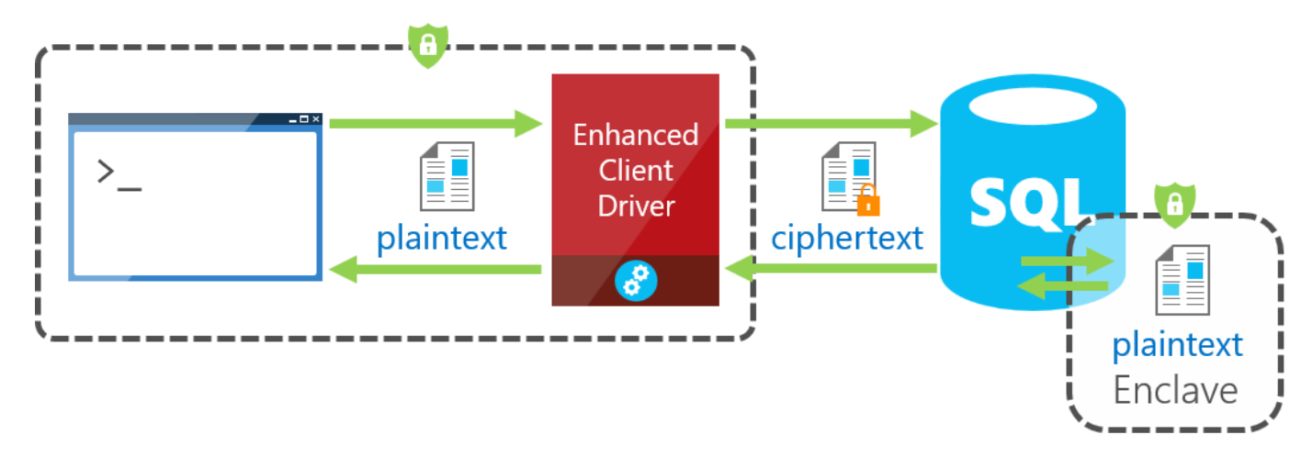
Implement secure data solutions
Implement Azure Confidential Compute
Trusted Execution Environments (TEEs)
New family of Azure virtual machines – DC Series
SQL Azure DB Always Encrypted with secure enclaves
Prototyping applications of Intel SGX, such as blockchain and multi-party machine learning
Read
aka.ms/SecureEnclaves
https://azure.microsoft.com/en-us/blog/azure-confidential-computing/
Notes:
Implement secure data solutions
May include but not limited to: Encrypt and decrypt data at rest and in transit; encrypt data with Always Encrypted; implement Azure Confidential Compute and SSL/TLS communications; create, read, update, and delete keys, secrets, and certificates by using the KeyVault API
SQL Server Engine delegates operations on encrypted to the SQL Enclave, where the data can be safely decrypted and processed
A secure enclave is a protected region of memory within the SQL Server process, and acts as a trusted execution environment for processing sensitive data inside the SQL Server engine. A secure enclave appears as a black box to the rest of the SQL Server and other processes on the hosting machine. There is no way to view any data or code inside the enclave from the outside, even with a debugger.
Read aka.ms/SecureEnclaves

Slide 43
Develop for the Cloud and Azure Storage 20-25% !
Develop solutions that use Cosmos DB storage
Develop solutions that use a relational database
Configure a message-based integration architecture
Develop for autoscaling
Notes:
aka.ms/az-300
aka.ms/az301

Slide 44
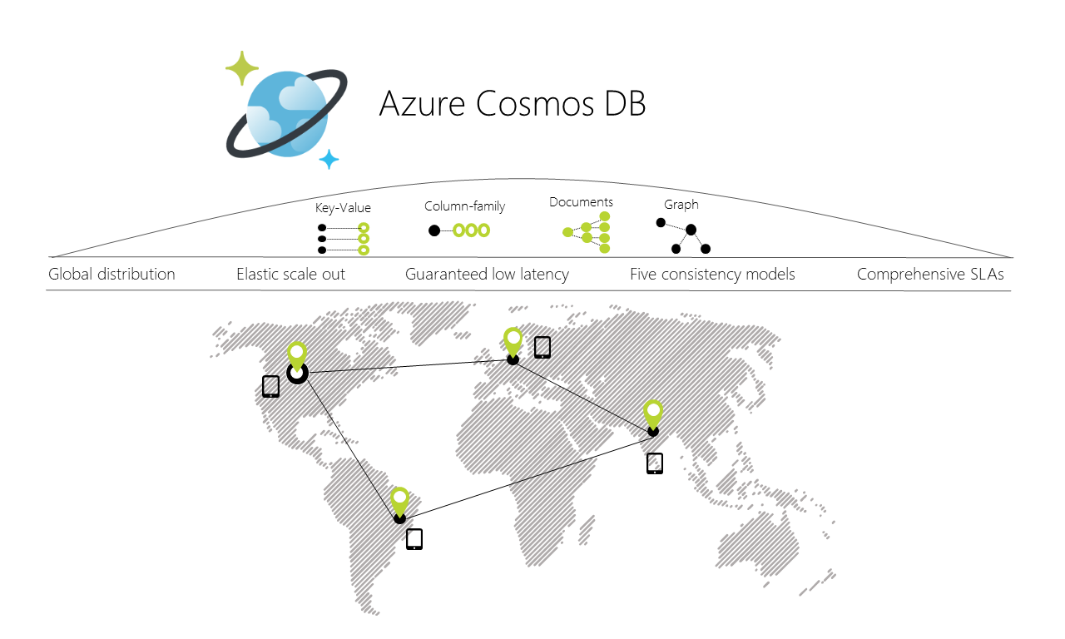
Develop solutions that use Cosmos DB storage
Notes:
Azure Cosmos DB is Microsoft's globally distributed, multi-model database service.
Cosmos DB enables you to build highly responsive and highly available applications worldwide.
Cosmos DB transparently replicates your data wherever your users are, so your users can interact with a replica of the data nearest to them.
Cosmos DB allows you to add or remove any of the Azure regions to your Cosmos account at any time, with a click of a button.
Cosmos DB will seamlessly replicate your data to all the regions

Slide 45


Cosmos DB Consistency Models
Strong
Bounded Staleness
Session
Consistent Prefix
Eventual
Set the appropriate consistency level for operations
Consider if several regions
an exception to 10 millisecond guarantee
Database Consistency Strength
Read & write Latency <10ms across all…except…
Read Tradeoffs
Notes:
Develop solutions that use Cosmos DB storage
May include but not limited to: Create, read, update, and delete data by using appropriate APIs; implement partitioning schemes; set the appropriate consistency level for operations
Azure Cosmos DB is Microsoft's globally distributed, multi-model database service.
Cosmos DB enables you to build highly responsive and highly available applications worldwide. Cosmos DB transparently replicates your data wherever your users are, so your users can interact with a replica of the data nearest to them.
Cosmos DB allows you to add or remove any of the Azure regions to your Cosmos account at any time, with a click of a button. Cosmos DB will seamlessly replicate your data to all the regions
Most commercially available distributed databases ask developers to choose between the two extreme consistency models: strong consistency and eventual consistency. Azure Cosmos DB allows developers to choose among the five well-defined consistency models:
Strong
bounded staleness
Session
consistent prefix
eventual.
Read Tradeoffs
https://docs.microsoft.com/en-us/azure/cosmos-db/consistency-levels-tradeoffs

Slide 46

Develop solutions that use a relational database
Configure Elastic Pools for Azure SQL Database
Create | Marketplace OR on SQL Server
Possible Changes
Change Tier
Scale performance and storage
Add/Remove Dbs
Min/Max Perf levels
Review Cost summary
Use PSH, CLI, T-SQL or REST API
Manage Pools
Notes:
Develop solutions that use a relational database
May include but not limited to: Provision and configure relational databases; configure elastic pools for Azure SQL Database; create, read, update, and delete data tables by using code
Manage Pools
https://docs.microsoft.com/en-us/azure/sql-database/sql-database-elastic-pool-manage

Slide 47

Configure a message-based integration architecture
Configure an Event Hub
Create
Namespace
Console Application
Add Event NuGet package
Write code to send messages to Event Hub
aka.ms/Azure/EventHubs
Big data streaming platform
Event ingestion service
Notes:
Azure Event Hubs is a big data streaming platform and event ingestion service. It can receive and process millions of events per second. Data sent to an event hub can be transformed and stored by using any real-time analytics provider or batching/storage adapters.
Configure a message-based integration architecture
May include but not limited to: Configure an app or service to send emails, Event Grid, and the Azure Relay Service; create and configure Notification Hub, Event Hub, and Service Bus; configure queries across multiple products

Slide 48
Event Hub Scenarios
Anomaly detection (fraud/outliers)
Application logging
Analytics pipelines, such as clickstreams
Live dashboarding
Archiving data
Transaction processing
User telemetry processing
Device telemetry streaming
Notes:
Event Hubs represents the "front door" for an event pipeline, often called an event ingestor in solution architectures.
An event ingestor is a component or service that sits between event publishers and event consumers to decouple the production of an event stream from the consumption of those events. Event Hubs provides a unified streaming platform with time retention buffer, decoupling event producers from event consumers.

Slide 49
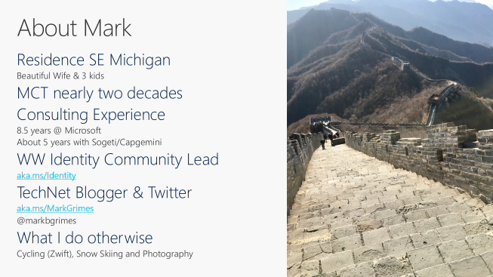
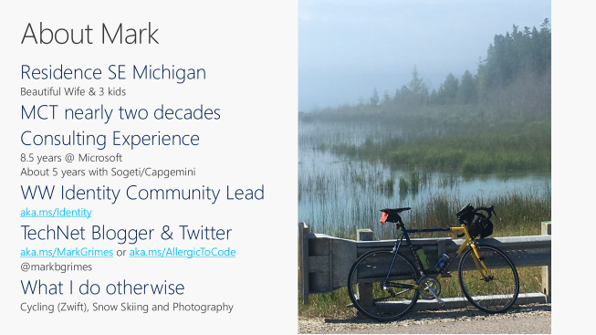
Microsoft Certification - Exam AZ-301 aka.ms/az-301

Slide 50
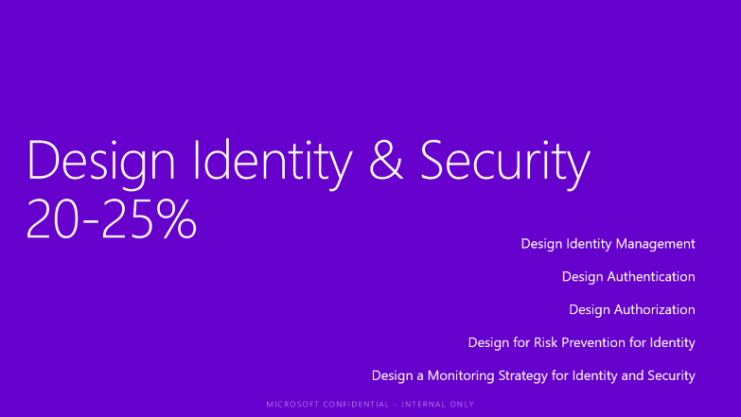
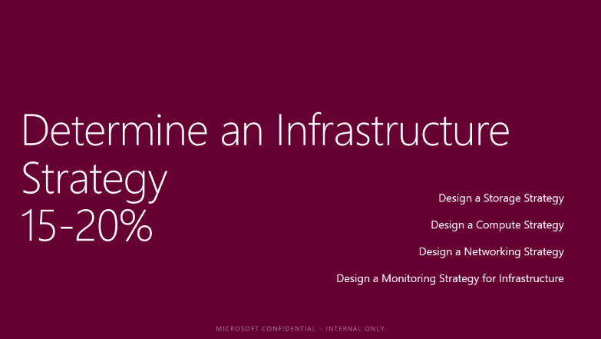
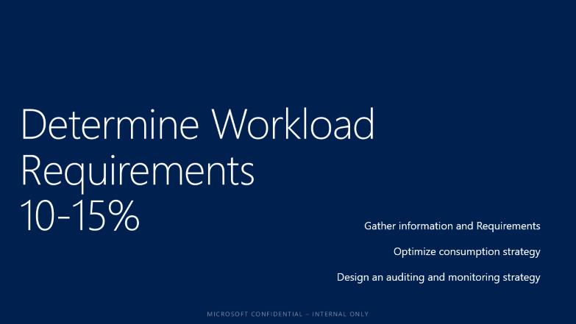
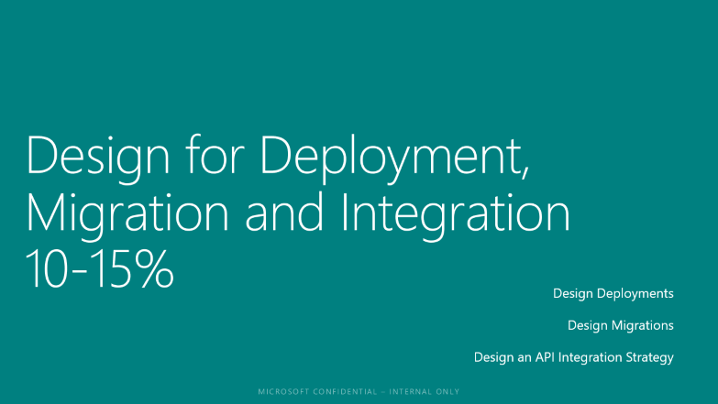


AZ-301 Objectives

Slide 51
Determine Workload Requirements 10-15%
Gather information and Requirements
Optimize consumption strategy
Design an auditing and monitoring strategy

Slide 52

Determine Workload Requirements
Gather information and requirements | Design Patterns
% of Uptime
Service Level Agreements
Why Need?
To Design Applications
To Maximize
Availability
Notes:
Gather Information and Requirements
May include but not limited to: Identify compliance requirements, identity and access management infrastructure, and service-oriented architectures (e.g., integration patterns, service design, service discoverability); identify accessibility (e.g. Web Content Accessibility Guidelines), availability (e.g. Service Level Agreement), capacity planning and scalability, deploy-ability (e.g., repositories, failback, slot-based deployment), configurability, governance, maintainability (e.g. logging, debugging, troubleshooting, recovery, training), security (e.g. authentication, authorization, attacks), and sizing (e.g. support costs, optimization) requirements; recommend changes during project execution (ongoing); evaluate products and services to align with solution; create testing scenarios
Availability is the proportion of time that the system is functional and working, usually measured as a percentage of uptime. It can be affected by system errors, infrastructure problems, malicious attacks, and system load. Cloud applications typically provide users with a service level agreement (SLA), so applications must be designed to maximize availability.

Slide 53




Determine Workload Requirements
Microsoft Ignite
Optimize Consumption Strategy
https://docs.microsoft.com/en-us/azure/cost-management/quick-acm-cost-analysis
Notes:
Optimize Consumption Strategy
May include but not limited to: Optimize app service, compute, identity, network, and storage costs

Slide 54

Determine Workload Requirements
Recommend appropriate monitoring tool(s) for a solution;
aka.ms/Azure/Monitor
Notes:
Design an Auditing and Monitoring Strategy
May include but not limited to: Define logical groupings (tags) for resources to be monitored; determine levels and storage locations for logs; plan for integration with monitoring tools; recommend appropriate monitoring tool(s) for a solution; specify mechanism for event routing and escalation; design auditing for compliance requirements; design auditing policies and traceability requirements
What data does Azure Monitor collect?
Azure Monitor can collect data from a variety of sources. You can think of monitoring data for your applications in tiers ranging from your application, any operating system and services it relies on, down to the platform itself. Azure Monitor collects data from each of the following tiers:
Application monitoring data: Data about the performance and functionality of the code you have written, regardless of its platform.
Guest OS monitoring data: Data about the operating system on which your application is running. This could be running in Azure, another cloud, or on-premises.
Azure resource monitoring data: Data about the operation of an Azure resource.
Azure subscription monitoring data: Data about the operation and management of an Azure subscription, as well as data about the health and operation of Azure itself.
Azure tenant monitoring data: Data about the operation of tenant-level Azure services, such as Azure Active Directory.

Slide 55

Aka.ms/Azure/Monitor
Microsoft Ignite
Notes:
Design an Auditing and Monitoring Strategy
May include but not limited to: Define logical groupings (tags) for resources to be monitored; determine levels and storage locations for logs; plan for integration with monitoring tools; recommend appropriate monitoring tool(s) for a solution; specify mechanism for event routing and escalation; design auditing for compliance requirements; design auditing policies and traceability requirements
What data does Azure Monitor collect?
Azure Monitor can collect data from a variety of sources. You can think of monitoring data for your applications in tiers ranging from your application, any operating system and services it relies on, down to the platform itself. Azure Monitor collects data from each of the following tiers:
Application monitoring data: Data about the performance and functionality of the code you have written, regardless of its platform.
Guest OS monitoring data: Data about the operating system on which your application is running. This could be running in Azure, another cloud, or on-premises.
Azure resource monitoring data: Data about the operation of an Azure resource.
Azure subscription monitoring data: Data about the operation and management of an Azure subscription, as well as data about the health and operation of Azure itself.
Azure tenant monitoring data: Data about the operation of tenant-level Azure services, such as Azure Active Directory.

Slide 56
Design Identity & Security 20-25%
Design Identity Management
Design Authentication
Design Authorization
Design for Risk Prevention for Identity
Design a Monitoring Strategy for Identity and Security

Slide 57
Design for Identity and Security
Design Identity Management
4 ways to assign rights
Personas and Roles
Access Control Strategies
identity based
conditional access
attribute-based
discretionary access
role based
responsibility based
4 Ways…
Direct
Group
Rule-based (dynamic group*)
External Authority
* requires P1 license
Notes:
Design Identity Management
May include but not limited to: Choose an identity management approach; design an identity delegation strategy, identity repository (including directory, application, systems, etc.); design self-service identity management and user and persona provisioning; define personas and roles; recommend appropriate access control strategy (e.g., attribute-based, discretionary access, history-based, identity-based, mandatory, organization-based, role-based, rule-based, responsibility-based)
* requires P1 license

Slide 58

Design for Identity and Security
Design Authentication – It’s all about the APPS!
Notes:
Design Authentication
May include but not limited to: Choose an authentication approach; design a single-sign on approach; design for IPSec, logon, multi-factor, network access, and remote authentication

Slide 59
Design for Identity and Security
Five Primary Application Scenarios supported by Azure AD
Single-page application (SPA) | Web browser to web application | Native application to web API | Web application to web API | Daemon or server application to web API
A user needs to sign in to a single-page application that is secured by Azure AD. | A user needs to sign in to a web application that is secured by Azure AD. | A native application that runs on a phone, tablet, or PC needs to authenticate a user to get resources from a web API that is secured by Azure AD. | A web application needs to get resources from a web API secured by Azure AD. | A daemon application or a server application with no web user interface needs to get resources from a web API secured by Azure AD.
Notes:
Design Authentication
May include but not limited to: Choose an authentication approach; design a single-sign on approach; design for IPSec, logon, multi-factor, network access, and remote authentication

Slide 60



Design for Identity and Security
Authorization Approach
Grant permissions
What you can or cannot do
Role Based Access Controls
Owner | Contributor | Reader
Built-In | Custom
Definitions | Assignments
aka.ms/Azure/RBAC
Notes:
Design Authorization
May include but not limited to: Choose an authorization approach; define access permissions and privileges; design secure delegated access (e.g., oAuth, OpenID, etc.); recommend when
and how to use API Keys.
Authorization is the act of granting an authenticated security principal permission to do something. It specifies what data you're allowed to access and what you can do with it.

Slide 61

Design for Identity and Security
Design for Risk Prevention for Identity | Access Reviews*
When to use
Need Continued Access
Auditors Access
Too many privileged roles
Where to use?
Azure AD Access Reviews
Azure AD Enterprise Apps
Azure AD PIM
* requires the Global Administrator, User Administrator, Security Administrator or Security Reader role.
aka.ms/Azure/AccessReview
Notes:
Design for Risk Prevention for Identity
May include but not limited to: Design a risk assessment strategy (e.g., access reviews, RBAC policies, physical access); evaluate agreements involving services or products from vendors and contractors; update solution design to address and mitigate changes to existing security policies, standards, guidelines and procedures
Azure Active Directory (Azure AD) Access Reviews enable organizations to efficiently manage group memberships, access to enterprise applications, and role assignments. User's access can be reviewed on a regular basis to make sure only the right people have continued access.
THINGS you can do…
Manage user access with Azure AD access reviews
Manage guest access with Azure AD access reviews
Manage programs and controls for Azure AD access reviews
Create an access review for members of a group or access to an application
Create an access review of users in an Azure AD administrative role

Slide 62
Design for Identity and Security
Design a Monitoring Strategy for Identity and Security
Azure AD Activity Logs
Filter
Route to
Storage Account
Azure Event Hub
Log Analytics
Activity
Sign-ins
Audit Logs
Security
Risky Sign-ins
Users flagged for risk
Who can access ?
Notes:
Design a Monitoring Strategy for Identity and Security
May include but not limited to: Design for alert notifications; design an alert and metrics strategy; recommend authentication monitors
Activity
Sign-ins – The sign-ins report provides information about the usage of managed applications and user sign-in activities.
Audit logs - Provides traceability through logs for all changes done by various features within Azure AD. Examples of audit logs include changes made to any resources within Azure AD like adding or removing users, apps, groups, roles and policies.
Security
Risky sign-ins - A risky sign-in is an indicator for a sign-in attempt that might have been performed by someone who is not the legitimate owner of a user account.
Users flagged for risk - A risky user is an indicator for a user account that might have been compromised.
Who can access the data?
Users in the Security Admininistrator, Security Reader or Global Administrator roles
In addition, all users (non-administrators) can see their own audit activities
https://docs.microsoft.com/en-us/azure/active-directory/reports-monitoring/concept-audit-logs#who-can-access-the-data

Slide 63
Design Data Platform Solution 15-20%
Design a Management Strategy
Design Data Protection Strategy
Design & Document Data Flows
Design a Monitoring Strategy for the Data Platform

Slide 64

Design a Data Platform Solution
Design a Data Management Strategy
Choose between
relational
non-relational databases
Caching Strategies
Azure Redis Cache
SSL
SLA 99.9%
Use the best data store for the job
aka.ms/Azure/DataArchitecture
Notes:
Design a Data Management Strategy
May include but not limited to: Choose between managed and unmanaged data store; choose between relational and non-relational databases; design data auditing and caching strategies; identify data attributes (e.g., relevancy, structure, frequency, size, durability, etc.); recommend Database Transaction Unit (DTU) sizing; design a data retention policy; design for data availability, consistency, and durability; design a data warehouse strategy
Caching is most effective when a client instance repeatedly reads the same data, especially if all the following conditions apply to the original data store:
It remains relatively static.
It's slow compared to the speed of the cache.
It's subject to a high level of contention.
It's far away when network latency can cause access to be slow.

Slide 65
Design a Data Platform Solution
Design a Data Protection Strategy | Encryption at Rest
Resource Providers’ support - > Azure Storage services
Disk Encryption | Bitlocker, DM-Crypt
Azure Key Vault
Storage Service Encryption | Storage Account objects
Read FAQ
Azure SQL
https://docs.microsoft.com/en-us/azure/security/azure-security-encryption-atrest
Notes:
Design a Data Protection Strategy
May include but not limited to: Recommend geographic data storage; design an encryption strategy for data at rest, for data in transmission, and for data in use; design a scalability strategy for data; design secure access to data; design a data loss prevention (DLP) policy
The feature automatically encrypts data in:
Azure storage services:
Azure Managed Disks
Azure Blob storage
Azure Files
Azure Queue storage
Azure Table storage.
Both performance tiers (Standard and Premium).
Both deployment models (Azure Resource Manager and classic).
Storage Service Encryption does not affect the performance of Azure storage services.

Slide 66

Design a Data Platform Solution
Design and Document Data Flows
Import Export
Scenarios
Migration to cloud
Content distribution
Backip
Data recovery
Azure Data Box
Notes:
Design and Document Data Flows
May include but not limited to: Identify data flow requirements; create a data flow diagram; design a data flow to meet business requirements; design a data import and export strategy
DATA BOX
Microsoft Azure Data Box cloud solution lets you send terabytes of data into Azure in a quick, inexpensive, and reliable way. The secure data transfer is accelerated by shipping you a proprietary Data Box storage device. Each storage device has a maximum usable storage capacity of 80 TB and is transported to your datacenter through a regional carrier

Slide 67

Design a Data Platform Solution
Microsoft Ignite
Design a Monitoring Strategy for the Data Platform
Alert on
Metric values
Log search queries
Activity Log events
Azure Health
Web sites’ availability
Read Options for Data Consumption !
aka.ms/Azure/Alerts
Notes:
Design a Monitoring Strategy for the Data Platform
May include but not limited to: Design for alert notifications; design an alert and metrics strategy
Across the Azure platform, we are bringing together monitoring data in a single place with the Azure Monitor pipeline, but practically acknowledge that today not all monitoring data is available in that pipeline yet. In this article, we will summarize the various ways you can programmatically access monitoring data from Azure services.
MSIT -Be as close to Native Azure as Possible
1. Make Stuff Go Away - really using it, or get rid of it
2. Move to SaaS
3. Move to PaaS
4. Move to IaaS
5. Leave on-prem

Slide 68
Design Business Continuity Strategy 15-20%
Design a Site Recovery Strategy
Design for High Availability
Design a Disaster recovery strategy
Design a Data Archiving Strategy

Slide 69

Design a Business Continuity Strategy
Design a Site Recovery Strategy
aka.ms/Azure/ASR
Notes:
Design a Site Recovery Strategy
May include but not limited to: Design a recovery solution; design a site recovery replication policy; design for site recovery capacity and for storage replication; design site failover and failback (planned/unplanned); design the site recovery network; recommend recovery objectives (e.g., Azure, on-prem, hybrid, Recovery Time Objective (RTO), Recovery Level Objective (RLO), Recovery Point Objective (RPO)); identify resources that require site recovery; identify supported and unsupported workloads; recommend a geographical distribution strategy

Slide 70

Design a Business Continuity Strategy
Blast radius
Design for High Availability
Availability Checklist
Resiliency Checklist
Notes:
Design for High Availability
May include but not limited to: Design for application redundancy, autoscaling, data center and fault domain redundancy, and network redundancy; identify resources that require high availability; identify storage types for high availability

Slide 71










Design a Business Continuity Strategy
Design for High Availability – Application Delivery
Preview
Application Gateway
Application Gateway
HTTP(S)
Front Door
Traffic Manager
Load Balancer
(Public)
Load Balancer (Internal)
Any protocol
Global
Region / Zone
Global
Regional
Internal
Route to your closest available service region or your on-prem DC. Offload SSL, improve performance / accelerate websites at the Edge.
Route across zones and into your VNET. Offload SSL and build your application-specific logic.
Route across and between your resources to build your regional application.
Notes:
Design for High Availability
May include but not limited to: Design for application redundancy, autoscaling, data center and fault domain redundancy, and network redundancy; identify resources that require high availability; identify storage types for high availability

Slide 72
Design a Business Continuity Strategy
Disaster Recovery Strategy for Individual Workloads
Data Residency boundary
Data Residency boundary
Region
Region 1
Region 2
Region 1
Region 2
Location 1
Location 2
High Availability
Data is replicated to a minimum of one additional location at low latency so data and application uptime is preserved.
Disaster Recovery
Asynchronous replication from one region to another, with standby VMs in the other region. Azure offers protection between regions within data residency boundaries.
Backup
Data is asynchronously replicated and stored for redundancy purposes with data residency options.
Notes:
Design a disaster recovery strategy for individual workloads
May include but not limited to: Design failover/failback scenario(s); document recovery requirements; identify resources that require backup; recommend a geographic availability strategy

Slide 73

Design a Business Continuity Strategy
Azure hot storage tier is optimized for storing data that is accessed frequently
Azure cool storage tier is optimized for storing data that is infrequently accessed and long-lived
Backups, media content, scientific data, compliance, and archival data
data seldom accessed - candidate for cool storage
aka.ms/Azure/Tiers
Notes:
Design a Data Archiving Strategy
May include but not limited to: Recommend storage types and methodology for data archiving; identify requirements for data archiving and business compliance requirements for data archiving; identify SLA(s) for data archiving

Slide 74
Design for Deployment, Migration and Integration 10-15%
Design Deployments
Design Migrations
Design an API Integration Strategy

Slide 75





Design Deployments
Design Deployments | App Services
Host
Windows Web Apps
Linux Web Apps
Docker Containers
Mobile apps
Functions
App Service Environments
Dedicated Environment
In your VNet
Very High Scale
Isolation and secure network access
High memory utilization
aka.ms/Azure/ASE
Feature Comparison, Scenarios & Recommendations
Azure Virtual Network
On Premises
ExpressRoute
App Service
Environment
Service Endpoints
Azure SQL
Azure Storage
Notes:
Design Deployments
May include but not limited to: Design a compute, container, data platform, messaging solution, storage, and web app and service deployment strategy
Azure App Service is a service for hosting web applications, REST APIs, and mobile back ends. You can develop in your favorite language, be it .NET, .NET Core, Java, Ruby, Node.js, PHP, or Python. Applications run and scale with ease on both Windows and Linux-based environments.
App Service not only adds the power of Microsoft Azure to your application, such as security, load balancing, autoscaling, and automated management. You can also take advantage of its DevOps capabilities, such as continuous deployment from Azure DevOps, GitHub, Docker Hub, and other sources, package management, staging environments, custom domain, and SSL certificates.
With App Service, you pay for the Azure compute resources you use. The compute resources you use is determined by the App Service plan that you run your apps on. F

Slide 76
Design for Deployment, Migration, and Integration
Design Migrations
Assess
Migrate
Optimize
Azure Migrate
Azure Site Recovery
Azure security and management (security, backup, monitoring, cost management)
Data Migration Assistant
Azure Database Migration Service
SQL Server Migration Assistant
Azure Data Box
Notes:
Design Migrations
May include but not limited to: Recommend a migration strategy; design data import/export strategies during migration; determine the appropriate application migration, data transfer, and network connectivity method; determine migration scope, including redundant, related, trivial, and outdated data; determine application and data compatibility

Slide 77

API Integration Strategy
Discover
Learn
Get access
Try
SDKs and samples
Get help
Connected experiences
Abstract
Secure and protect
Manage lifecycle
Monitor and measure
Onboard developers
Monetize
Consume
Mediate
Publish
Developer portal
API Gateway
Azure portal
APIs
Developers
(use APIs)
Publishers
(provide APIs)
Services and data
aka.ms/Azure/APIMgt
Notes:
Design an API Integration Strategy
May include but not limited to: Design an API gateway strategy; determine policies for internal and external consumption of APIs; recommend a hosting structure for API management
API Management provides the core competencies to ensure a successful API program through developer engagement, business insights, analytics, security, and protection. You can use Azure API Management to take any backend and launch a full-fledged API program based on it.
To use API Management, administrators create APIs. Each API consists of one or more operations, and each API can be added to one or more products. To use an API, developers subscribe to a product that contains that API, and then they can call the API's operation, subject to any usage policies that may be in effect. Common scenarios include:
Securing mobile infrastructure by gating access with API keys, preventing DOS attacks by using throttling, or using advanced security policies like JWT token validation.
Enabling ISV partner ecosystems by offering fast partner onboarding through the developer portal and building an API facade to decouple from internal implementations that are not ripe for partner consumption.
Running an internal API program by offering a centralized location for the organization to communicate about the availability and latest changes to APIs, gating access based on organizational accounts, all based on a secured channel between the API gateway and the backend.
The system is made up of the following components:
The API gateway is the endpoint that:
Accepts API calls and routes them to your backends.
Verifies API keys, JWT tokens, certificates, and other credentials.
Enforces usage quotas and rate limits.
Transforms your API on the fly without code modifications.
Caches backend responses where set up.
Logs call metadata for analytics purposes.
The Azure portal is the administrative interface where you set up your API program. Use it to:
Define or import API schema.
Package APIs into products.
Set up policies like quotas or transformations on the APIs.
Get insights from analytics.
Manage users.
The Developer portal serves as the main web presence for developers, where they can:
Read API documentation.
Try out an API via the interactive console.
Create an account and subscribe to get API keys.
Access analytics on their own usage.

Slide 78
Determine an Infrastructure Strategy 15-20%
Design a Storage Strategy
Design a Compute Strategy
Design a Networking Strategy
Design a Monitoring Strategy for Infrastructure

Slide 79


Design an Infrastructure Strategy
Design a Storage Strategy | Storage Management Tools
PowerShell Cmdlets
Azure CLI Cmdlets
Azcopy
Azure Storage Explorer
Azure Storage Client Tools
Azure Developer Tools
aka.ms/Azure/Storage
Notes:
Design a Storage Strategy
May include but not limited to: Design a storage provisioning strategy; design storage access strategy; identify storage requirements; recommend a storage solution and storage management tools

Slide 80


Design an Infrastructure Strategy
Design a Compute Strategy | Azure HPC Environment
Big compute w/ Azure Batch
Hybrid HPC in Azure w/ HPC Pack
aka.ms/Azure/HPC – see solution architectures
Watch HPC in Azure – Ignite 2018
Notes:
Design a Compute Strategy
May include but not limited to: Design compute provisioning and secure compute strategies; determine appropriate compute technologies (e.g., virtual machines, functions, service fabric, container instances, etc.); design an Azure HPC environment; identify compute requirements; recommend management tools for computeB
BIG compute with Azure Batch
This solution is built on the Azure managed services—Virtual Machines, Storage, and Batch. These services run in a high-availability environment, patched and supported, allowing you to focus on your solution
Hybrid HPC in Azure w/HPC Pack
Microsoft HPC Pack is a free high performance computing (HPC) solution built on Microsoft Azure and Windows Server technologies. HPC Pack combines a comprehensive set of deployment, administration, job scheduling, and monitoring tools for your Windows and Linux HPC cluster environment, providing a flexible platform for developing and running HPC applications on premises and in Azure.
This solution shows the process for using HPC Pack to create a hybrid (on-premises and Azure) HPC environment.

Slide 81















Design an Infrastructure Strategy
Design a Networking Strategy | Recommend Tools
Review
Integrate
Metrics Explorer
Network Topology
Diagnostic Logs
Dashboards
Alerts
Azure Monitor
Event Hubs
Logic Apps
3rd Party
Troubleshoot
Optimize
Connection Troubleshoot
Connection Monitor
VPN Troubleshoot
Packet Capture
Virtual Network TAP
NSG Flow logs
Traffic Analytics
NPM
Network Watcher
Network Performance
Monitor (NPM)
Watch Monitoring your Networks in Azure
Notes:
Design a Networking Strategy
May include but not limited to: Design network provisioning and network security strategies; determine appropriate network connectivity technologies; identify networking requirements; recommend network management tools

Slide 82

Design Monitoring Strategy
Application
Host
Infrastructure
Platform
Application Insights
Web Application Firewalls
Vulnerability Scanners
Microsoft Monitoring Agent
Service Map and other Log Analytics Solution Packs
Azure Security Center
Azure Monitor
Secure DevOps kit for Azure (AzSK)
Network Watcher
Activity Logs
Azure Monitor
Azure Health
aka.ms/Azure/Monitor
Open your Portal!
Notes:
Design a Monitoring Strategy for Infrastructure
May include but not limited to: Design for alert notifications; design an alert and metrics strategy

Slide 83
Resources
NEW role-based certification: aka.ma/RoleBasedCert
Microsoft Certification & Training overview: Microsoft.com/Learning
Microsoft Certification overview: aka.ms/MSCert
Learning Partners: aka.ms/LearningPartners
Microsoft Learn: Microsoft.com/Learn
Azure certification exams: aka.ms/ExamsAzure
Microsoft 365 training: aka.ms/Microsoft365Learn

Slide 84
Call to action
Take at the onsite testing center @ the Sheraton hotel
Preregister for your exams at www.microsoftready.com/certification
Visit the Certification team in the Learning Zone

Slide 85


Thank you! Questions? Microsoft Certification @ Ready

Slide 86

Enjoy a session
Fill out an eval
Win a prize
Make MS Ready better
Evaluations can be submitted via
Laptop/Mobile connect to Schedule Builder on www.microsoftready.com
App Install (Windows, iOS, Android Platforms supported; search “MS Ready” in App Stores)
Your Mobile Device scan the QR code to reach your evals
*If you plan to remain in this room for the next session, please be sure to scan your badge again at the door prior to the session starting

Slide 87
Microsoft Certification - Addendum

Slide 88
Exam Question Types
Microsoft Office Specialist
Performance-based test (runs in Office directly)
Microsoft Technology Associate
Multiple Choice questions
MCSA and MCSE
Multiple Choice, Build List, Active Screen, Graphic Interpretation, Hot Area, etc…

Slide 89

MCP Exam Basics
40-60 questions
1-4 hours to complete the exam
All questions are worth “one point” unless told otherwise.
Cannot move between case studies
700 is passing but 700 70%

Slide 90
How to interpret the questions
Business Problem
All questions have a consistent anatomy
Goal Statement
One or Multiple Correct Answers
Questions are not intended to trick you
Multiple Distractors

Slide 91
Question types go beyond multiple choice
Hot Area
Extending Matching items
Code Review
Case Studies
Graphic Interpretation
Short Answer Code
Active Screen
Drag & Drop
Build Lists
Best Answer

Slide 92
In review:
Next Steps
Get credentialed in FY19 / FY20
…

